Slide 1
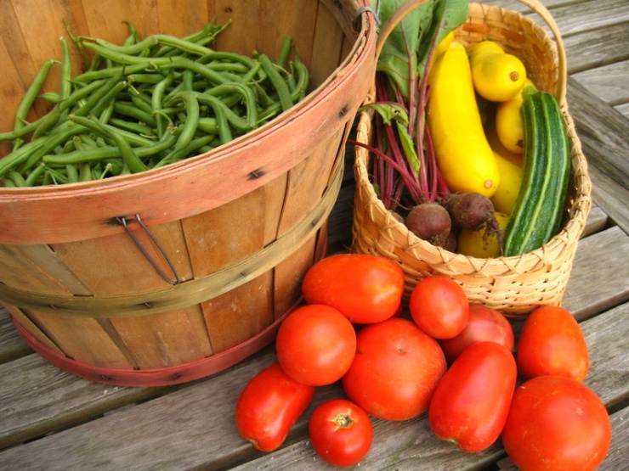
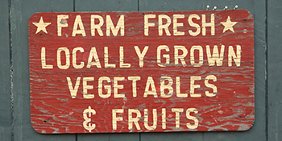
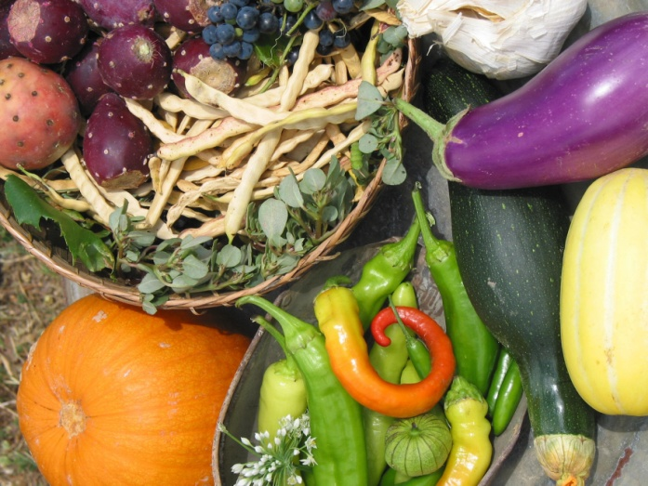
How is Local Food Good for Our Economy?

Slide 2
What is an Economy?
The system by which goods and services are produced, sold, and bought that helps us determine how to use limited resources.
Everything we MAKE (or GROW)
Everything we BUY
How resources are USED
Notes:
Goods: example – potatoes, apples, etc.
Services: example – doctors, distributors – someone who provides a service
Resources: example – oil, coal, wood, etc. (ask Tresine about her 4 resources)

Slide 3
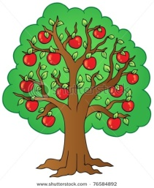
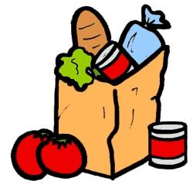
Economics
Production (What gets made and how?)
Distribution (How do we get things to people who want them?)
Consumption of goods and services (What do people want, how much, and what price?)
The Big Question:
How can we satisfy unlimited wants …with limited resources?
Notes:
Economics Analyzes the
Production – example – growing apples on a farm
Distribution – example – farmer sells apples to school
Consumption – example - students eat local apples
The Big Question – everybody likes apples, but I only have 1 apple; economics decides who gets it

Slide 4
Economics
Helps us decide:
What goods & services get produced
How they are produced
Who gets them
Who answers all of these questions?
YOU answer these questions as a CONSUMER
Notes:
Goods & services (food); how food is produced; who gets the food
Consumer syn. Customer
Children are the consumer/customer and have the power to decide what goods to buy (or what is purchased for them)

Slide 5
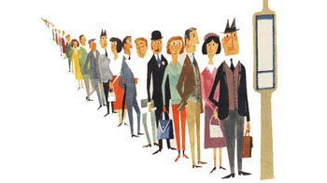
Intro to Supply & Demand
Supply
How much is available to us?
What price can it be sold for?
Demand
How much do we want?
What price are we willing to pay?

Slide 6
Economics: Supply & Demand
Price
Supply
$1
Demand
1
Quantity
Notes:
Optional – explanation: We create Demand, based on how much we are willing to pay for an apple. ($1? $10?)
That is how an economic decision gets made.
Every time you or your parents decide to purchase something, they are telling the supplier (in this situation, an apple farmer) how much you want and how much you are willing to pay for it.

Slide 7
Economics: Supply & Demand
Supply
Price decreases when more supply is available
especially when demand is low!
Demand
Price increases when demand is high
Especially when supply is low!
Notes:
Ex – Supply: If every farmer decided to start growing apples, then apples would be very cheap.
Ex – Demand: If everyone in the whole world wanted popcorn when they went to the movies, then the movie theater could charge anything they wanted for the popcorn. And they do!

Slide 8
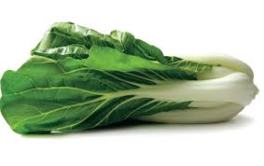
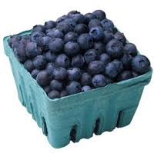
Economics: Supply & Demand
Which of these foods do you think farmers sell more of?
Bok choy
Blueberries
WHY?
Notes:
Familiarity –
Seasonality – shorter window of harvest for blueberries
Taste – sweet vs. not sweet
Preparation – pick and eat vs. cooking

Slide 9
Farm to School Benefits
Farmers have a new place to sell their local food!
Local farmers get to keep more $MONEY$
YOU get to eat tasty, local, & healthy food!
That $MONEY$ stays INSIDE the community!

Slide 11
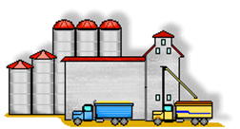
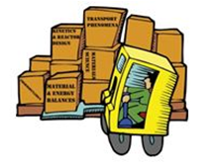
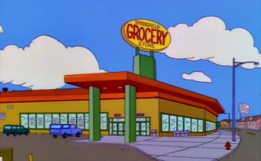
Economics: Supply Chain
Farmer
Farmer
Processor
School
VS.
Distributor
YOU!
Retailer
YOU!
Notes:
Money Activity:
Materials List: 10 fake $1 bills, 1 piece of fruit, paper signs for each role to hold or hang around their necks
(kit available for check-out)
6 children are at the front of the room and have roles as a Farmer, Processor, Distributor, Retailer, School, or You (the Consumer).
The Farmer passes the apple to the Consumer through all of the other students; the Consumer passes the money through the chain of students. Each student/role takes $2 and the Farmer is left with $4.
Repeat with the Farm to School chain of students(take out the Processor, Distributor, Retailer); the Farmer gets to keep $8.

Slide 12
Why can’t we always get all foods locally?
Can you grow bananas in KY? Oranges?

Slide 13
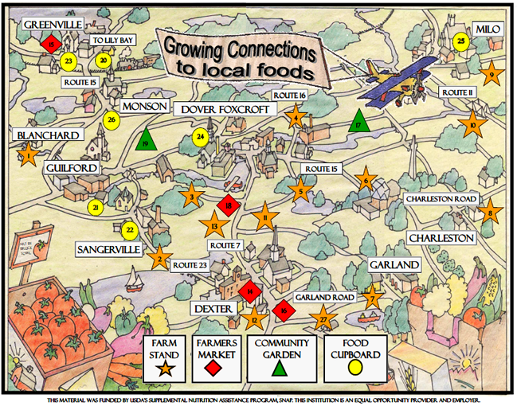
Do you know where to buy local?
Farmers Market
Farm stands
Some grocery stores
Gardens
Orchards
Farms
Food Banks

Slide 14
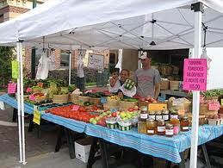
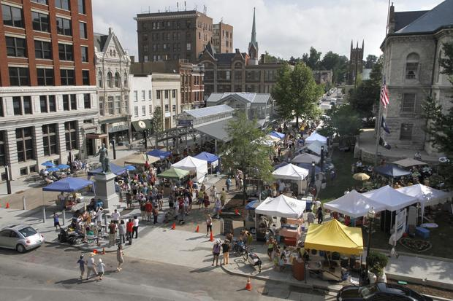
Have you been to the Farmers Market???

