Slide 1




Farm to School Nutrition

Slide 2
Plants need air,
sun and water to grow.
What do YOU need to grow?
Notes:
Who would you ask to learn more about healthy eating? (click to next slide)

Slide 3
Talk to a Registered Dietitian or your school’s Cafeteria
Manager about
healthy choices.
Notes:
-Introduce Cafeteria Manager
-Explain role of a registered dietitian as a potential career path (important in 4th and 5th grade):
Registered dietitian’s definition: food and nutrition experts who learn about the science of how food works in our bodies and explains this to people who want to live healthier lives, especially if they have different diseases like diabetes, or heart disease. They work throughout the community in hospitals, schools, public health clinics, nursing homes, fitness centers, food management, food industry, universities, research and private practice.
-If you would like a Registered Dietitian to visit for your lesson please contact Nancy Hiner, Registered Dietitian, Lexington Health Department: (859) 288-2344
-Dietitian guest speakers should answer the following questions: What interested them in the profession? When and why the profession became their passion? And what did you do to prepare as a kid for that career pathway? Why is being a registered dietitian so fun?
-How many years of school do you need to become a dietitian after high school ? It takes about 5 years after high school to become a Registered Dietitian. They have a degree from a university (usually in food science). This takes 4 years. Then they have to finish a 6-12 month long internship, where they work with someone who is already a dietitian and learn hands-on. Then, they must pass a national exam to show they understand all what they’ve learned.
-Please go to: http://www.eatrightpro.org/resources/about-us/what-is-an-rdn-and-dtr for more information on the role and education components of a being a registered dietitian

Slide 4
Why is Good Nutrition Important?
Helps your body GROW
Helps your body REPAIR body tissues like muscles and skin
Provides all the NUTRIENTS we need to stay healthy
Keeps our IMMUNE SYSTEM healthy so we do not get sick
Provides ENERGY so that you can move and learn!
Notes:
For younger kids, you can use the “GROW, GLOW, & GO” expression to describe importance of nutrition.

Slide 5
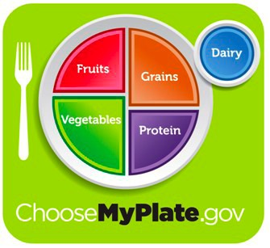
A great way to make sure you are eating the right foods in the right amounts.
Notes:
A healthy meal has foods from all the groups on the plate.
Let’s start by talking about fruits & veggies. They take up ½ of the plate and they come in all sorts of bright colors! (click to next slide)

Slide 6

Nature
has color coded
our food. Eating
a rainbow = eating the Nutrients your body needs.
Notes:
-Introduce the word "nutrients“.
-Key points for students:
Nutients are “ingredients” of food or what foods are made of. There are 6 nutrient groups: FAT, CARBOHYDRATE, PROTEIN, VITAMINS, MINERALS, WATER.
Some foods have more nutrients than others
Eating all these colors is very important for your body to be healthy and work correctly.
Examples of nutrient rainbow:
-RED foods: contain Potassium – keeps heart beating correctly.
-YELLOW & ORANGE foods: contain Vitamin A and Phytochemicals that keep eyes strong and your immune system healthy (which keeps us from catching colds, helps us to get over being sick faster)
-GREEN foods: contain Fiber – keeps you digestive tract working
-BLUE/PURPLE foods: contain antioxidants the help prevent cancer, keep skin healthy, help cuts heal quickly.
Ask the students to name their favorite brightly colored fruits/veggies.

Slide 7
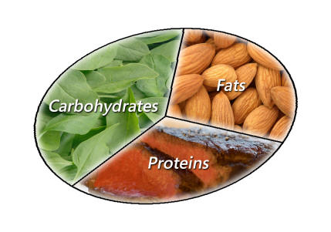

6 Essential Nutrients
Water
Carbohydrates
Proteins
Fats
Vitamins
Minerals
We need larger amounts of these
We need smaller amounts of these

Slide 8

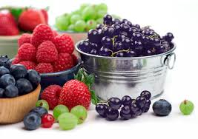
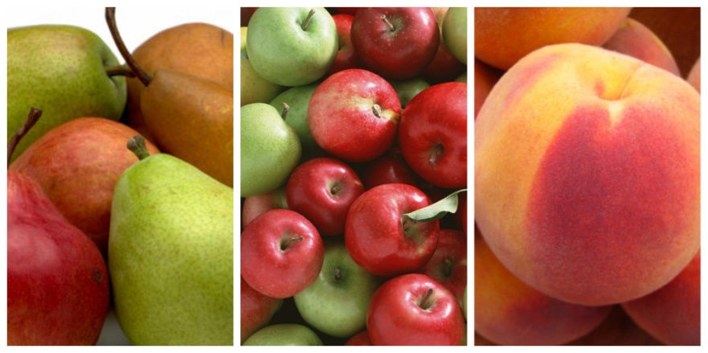
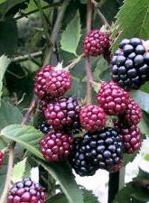
FRUIT
Fiber, Potassium,
Vitamin C, and Folic Acid
Goal: 1-1 ½ cups a day
School fruit = 1/2 cup
School juice = 3/4 cup

Slide 9

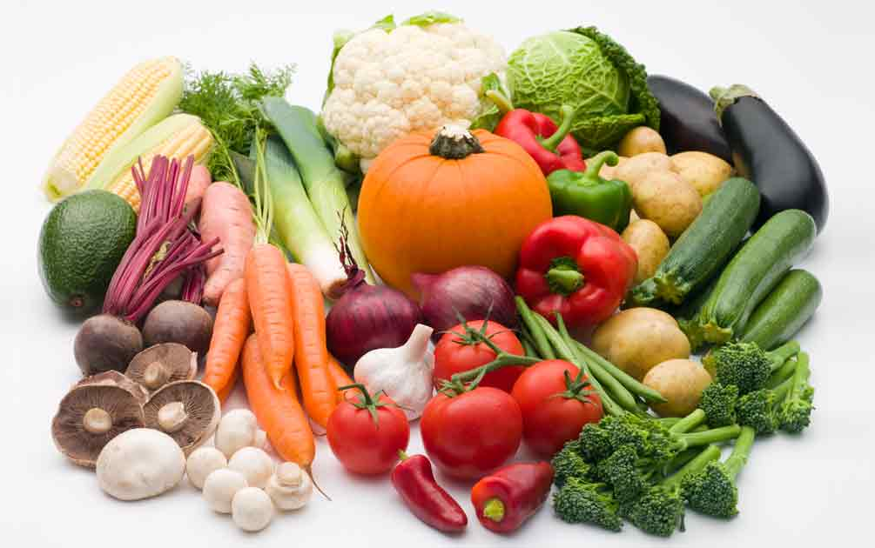
VEGETABLES
Fiber, Potassium, Folic Acid, Vitamin A, Vitamin E, and Vitamin C.
Goal: 1 ½-2 cups a day
School vegetables =
1/2 cup

Slide 10

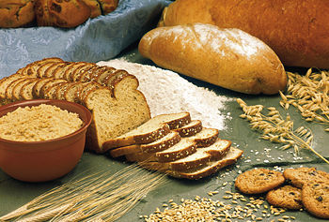
GRAINS
Fiber, B vitamins,
Magnesium, Iron
Goal: 2-3 servings a day
School lunch portion:
1 slice bread
or bun =1 serving
Rice or pasta = ½-1 cup
Notes:
Whole grains are best.

Slide 11

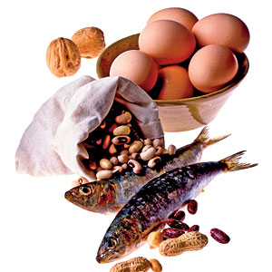
PROTEIN
Meat, poultry, fish, beans, eggs, nuts, and seeds
Vitamin E, Iron, Zinc, Magnesium, B vitamins
Goal: 3-5 oz./day
School lunch = 1-2 oz.

Slide 12


DAIRY
Milk & Milk Products
Calcium, Potassium,
Vitamin D
Goal: 2-3 servings/day
1 serving =
1 cup milk or yogurt
1 piece cheese
Notes:
Calcium keeps your bones strong! You need three servings a day. One is offered at breakfast and one at lunch.

Slide 13


Tip: Avoid Nutrient Degradation.
Vitamins and minerals can be lost by:
    Time Heat
    Light Air Exposure
Notes:
“Nutrient Degradation” is big vocabulary word for today’s lesson.

Slide 14








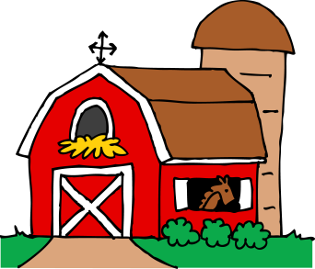

Day 1
Day 2
Processing Plant
Farm
Distributor
Day 4
Which food has more nutrients?
Day 3
Day 5
School
Farm
School
Notes:
Does fresh food taste better? How many of you have tasted a strawberry off the vine?
-Fresh produce needs to fully ripen on the vine to get the most nutrients
The longer they are in “transit” from farm to consumer, the more nutrients they loose.
Organic and conventional (non-organic) fruits & veggies contain same amount of big nutrients like protein/fat/carbohydrate. Only vitamins/minerals vary.
Produce can be frozen to lock-in vitamins/minerals and prevent degradation. Frozen fruits/veggies is a good option when local is not available.
-Question for students: What carrot has the most nutrients?
a) a carrot that was picked ripe and eaten within 24 hours?
b) a carrot picked early (before ripe) and eaten within 24 hours?
c) a carrot picked ripe and eaten within 4 hours? (correct)
d) a carrot picked ripe and eaten within 24 hours?

Slide 15
Get the MOST nutrients you can by:
Eating locally grown foods, when possible, frozen foods when not
Don’t over-cook or process

Slide 16
We get new taste-buds over time.
Try something new,
you might just
love it!
Notes:
Tell students a personal experience of a time you tried something and then later enjoyed it - ask the students the same question

Slide 17
Slide about this week’s local product

Slide 18
Slide about this week’s local product

