Slide 1
Capturing Health:
Voices Through Photos in CHAs
Presented by: ​
Dr. Margaret McGladrey, PhD
Jeanette Hart, MBA
Christina Nentwick, BA
Contributors:
Erin Connors, BS
Stacey Li, BSPH

Slide 2
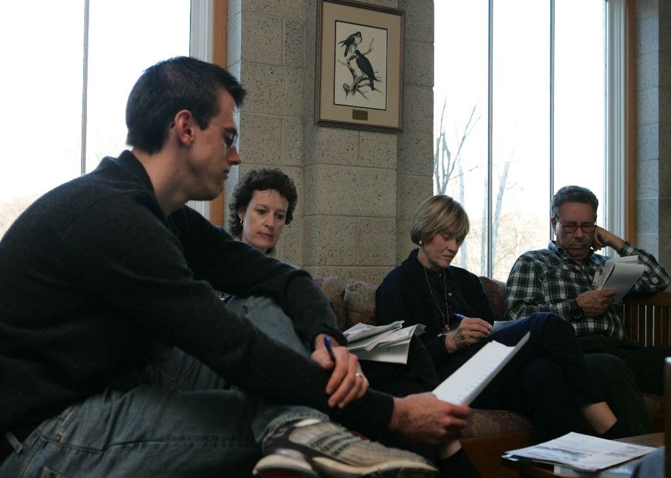
Learning Objectives
Discuss how Photovoice supports community engagement in CHA/CHIP work around stigmatized public health issues, like
behavioral health.
Assess how the Photovoice method
enhances mixed-methods data collection (quantitative and qualitative) for the CHA process and documentation for
accreditation.

Slide 3
What is Photovoice?
Three Primary Goals of Photovoice
Bringing together participants to recognize community health strengths and concerns, which they can creatively capture through their own photography.
Guiding group discussions to analyze and understand the reasons for community health issues prioritized by the group.
Engaging decision-makers through exhibits and other dissemination methods to inspire social action and the implementation of health-promoting policies.
Wang, C., & Burris, M. A. (1997). Photovoice: Concept, Methodology, and Use for Participatory Needs Assessment. Health Education & Behavior, 24(3), 369–387. https://doi.org/10.1177/109019819702400309

Slide 4
Photovoice
Benefits and Applications
- Method for empowering participants and generating critical consciousness of community issues.
- Due to its ability to facilitate disclosure management, Photovoice has been employed with numerous minoritized and stigmatized groups:
People living with HIV, gender non-binary young adults, people with mental illness, substance use disorder, physical disabilities, and people experiencing houselessness.
- Applied to a wide range of topics in health, architecture and urban design, and social justice.
Carlson ED, Engebretson J, Chamberlain RM. Photovoice as a Social Process of Critical Consciousness. Qual Health Res. 2006;16(6):836-852. doi:10.1177/1049732306287525
Seitz CM, Orsini MM. Thirty Years of Implementing the Photovoice Method: Insights From a Review of Reviews. Health Promot Pract. 2022;23(2):281-288. doi:10.1177/15248399211053878
Strack RW, Orsini MM, Ewald DR. Revisiting the Roots and Aims of Photovoice. Health Promot Pract. 2022;23(2):221-229. doi:10.1177/15248399211061710

Slide 5
Photovoice Process
Photography
Take photos illustrating the topics selected by the group between sessions
Collaborative Analysis
Facilitators conduct preliminary analysis of photo discussion notes using the Socioecological Framework and identify key themes
Orientation
Covers Photovoice goals, ethics of photography, informed consent, and topic development using nominal group technique
Photo Discussions
Two group photo discussions on community health strengths and concerns following the SHOWeD method
Analysis and Action Planning
Review thematically organized photos; analyze photo discussion notes and use them to write captions; and prepare for community forums

Slide 7
What Does Mental Health Mean to You?

Slide 8
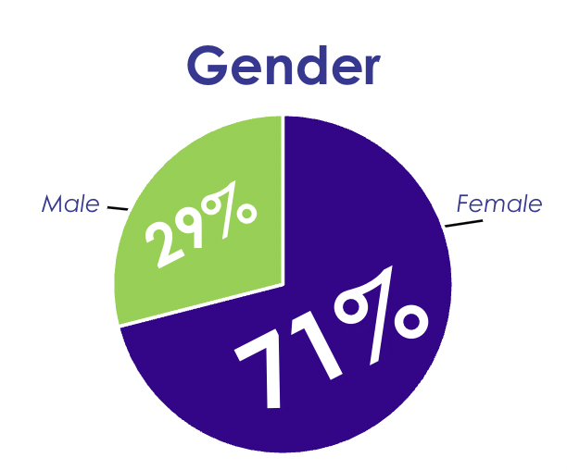
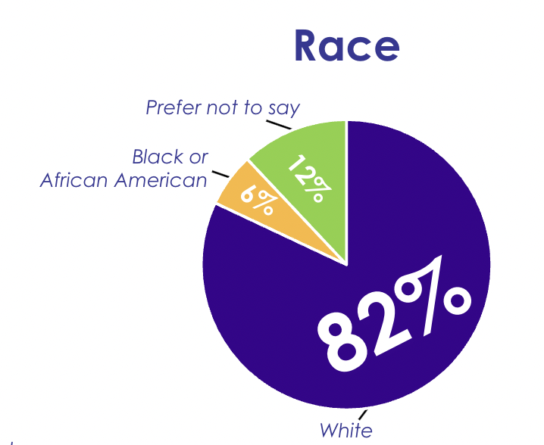
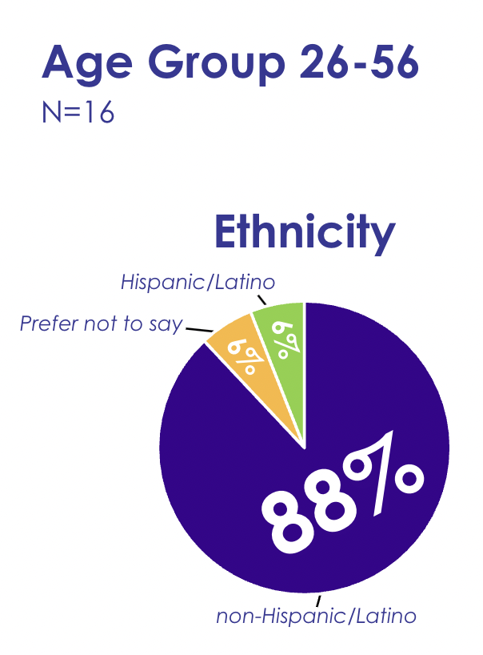
Lexington-Fayette County
Photovoice Team Demographics

Slide 9
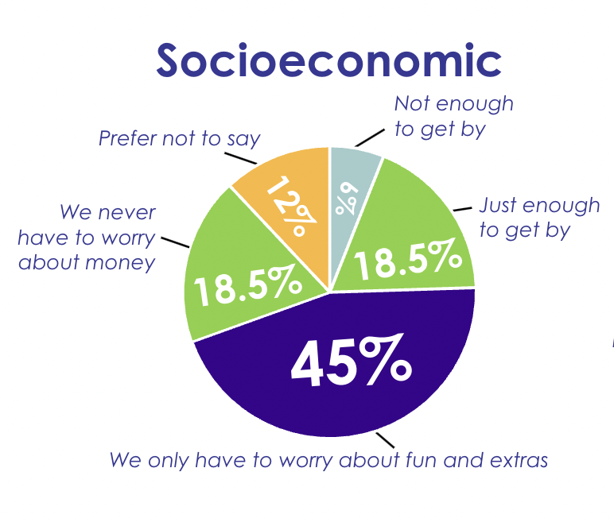
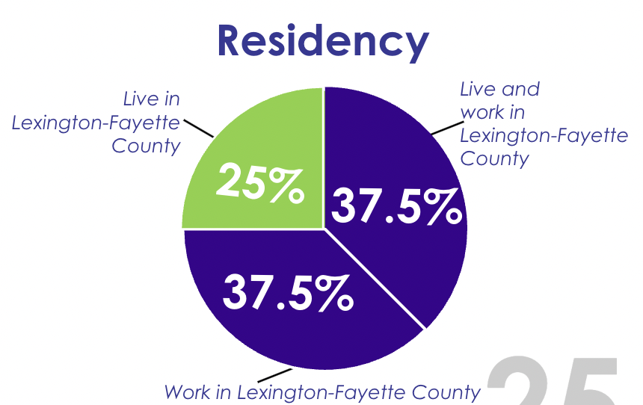
Lexington-Fayette County
Photovoice Team Demographics

Slide 10
Lexington-Fayette County
Photovoice Team Characteristics

Slide 11
Lexington-Fayette County
Photovoice Team Characteristics

Slide 12
Photovoice Submission:
Community Strength

Slide 13
Photovoice Submission:
Community Concern

Slide 14
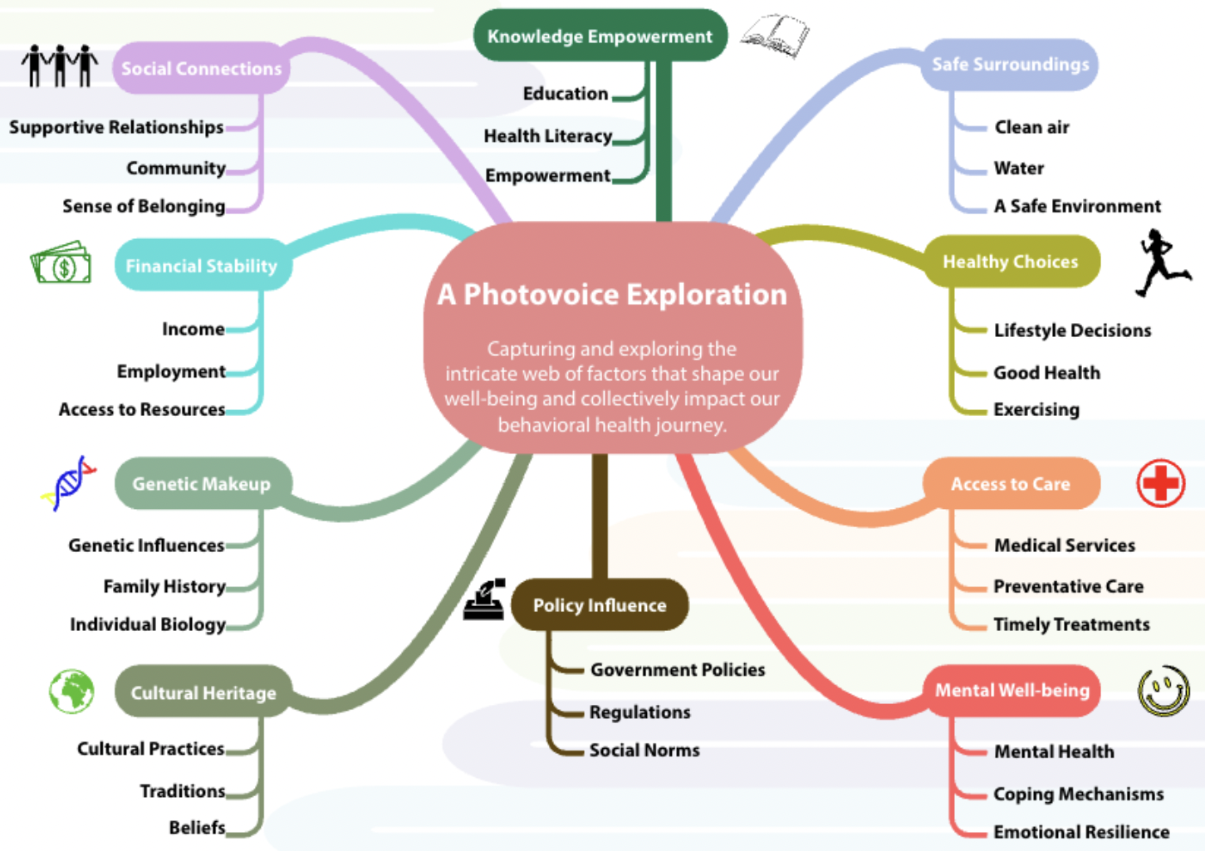
A
Web
of
Voices

Slide 15
Using Photovoice to Explore Behavioral Health
Community benefits from a deeper understanding of community perspectives and needs.
Enrich CHA behavioral health survey data by engaging community members to capture personal experiences and unique perspectives that are not represented by survey data.
Amplify community voices within Lexington-Fayette County to illustrate lived experiences with stigmatized public health issues: behavioral health, mental health, substance use disorders.
Photovoice is demonstrated to be an effective anti-stigma tool.
Tippin GK, Maranzan KA. Photovoice as a Method to Reduce the Stigma of Mental Illness Among Health Care Students. Health Promot Pract. 2022 Mar;23(2):331-337. doi: 10.1177/15248399211057152. PMID: 35285317; PMCID: PMC8921880.
Russinova, Z., Mizock, L., & Bloch, P. (2018). Photovoice as a tool to understand the experience of stigma among individuals with serious mental illnesses. Stigma and Health, 3(3), 171–185. https://doi.org/10.1037/sah0000080

Slide 16
Identified Behavioral Health
Strengths & Concerns
Strengths Only
Strengths & Concerns
Concerns Only
Harm reduction & recovery supports
Community spaces/organizations promoting creative expression
Public libraries as mental health infrastructure
- Gun violence
- Substance use disorder
- Disinvestment in BIPOC communities
- Response to hidden/invisible disabilities
- Gentrification/affordable housing
- Apathy/not knowing how to help
- Social isolation of rural services
- Remembering & forgetting our local history
- The faith community
- Access to natural environments and the outdoors
- Impact of behavioral health resources limited by lack of awareness
- Services for migrant and refugee communities are sometimes undermined by bias​
- Inclusivity and discrimination faced by the LGBTQ+ community​
- Farmers’ markets and food deserts

Slide 17
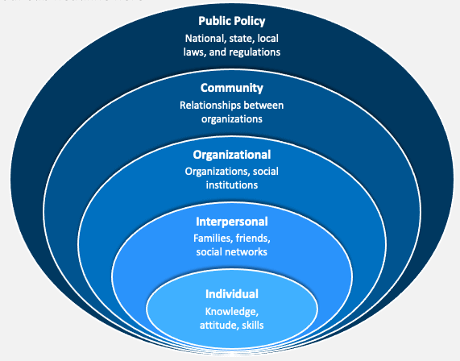
Identified Supports & Challenges of Behavioral Health: Individual
Supports
Access to nature
Community involvement
Challenges
Forgetting local history
Apathy
Discomfort in helping others

Slide 18
Identified Supports & Challenges of Behavioral Health: Intrapersonal
Challenges
Social isolation of rural elders
Unseen disabilities
Biases facing migrant and refugee communities

Slide 19
Identified Supports & Challenges of Behavioral Health: Organizational
Challenges
Mistreatment of historical sites
Biases
Lack of awareness of available resources
Supports
Harm reduction programs
Services for migrant and refugee communities
Public library's role in mental health infrastructure

Slide 20
Identified Supports & Challenges of Behavioral Health: Community
Supports
Faith community initiatives
Community spaces promoting creative expression
Inclusivity of the LGBTQ+ community
Challenges
Impact of behavioral health resources limited by awareness
Gun violence
Substance use disorder
Discrimination
Issues related to farmers' markets and food deserts

Slide 21
Identified Supports & Challenges of Behavioral Health: Public Policy
Challenges
Gentrification and affordable housing
Transportation challenges
Disinvestment in BIPOC communities

Slide 22
Interactive Photovoice Session
Engage, Explore, & Share Your Perspectives
Please take out your smartphones.
Browse your photo gallery and select an image that could represent behavioral health
in your community.
Share your selected photo with your small group. Discuss:
Why did you choose your image?
How does it relate to the behavioral health?
Be ready to share your group's insights with the larger group after
10 minutes of discussion.
Send to Lex-CHIP@lfchd.org
Share your demographics with us for our data by visiting: https://www.surveymonkey.com/r/KPHAPhotovoice
Reminder:
Respect privacy and confidentiality. Please only share photos you are comfortable discussing in this setting.

Slide 24
2023 Community Health Assessment
https://www.lfchd.org/18799-doweis

Slide 25
Questions?
Notes:
4:55pm

Slide 26
Thank you!
Contact Information
Jeanette Hart
JeanetteA.Hart@lfchd.org
Dr. Margaret McGladrey
margaret.mcgladrey@uky.edu
Christy Nentwick
Christinar.Nentwick@lfchd.org
Notes:
5:00pm

