Slide 1
Kentucky TB Program Lunch and Learn
Week 7. Treatment of Latent Tuberculosis Infection
Connie A. Haley, MD MPH
Public Health and Tuberculosis Consultant
Connie.haley@comcast.net
July 30, 2026
Notes:
Modern TB Screening in Long‑Term Care: What’s Changed and What Matters Now
Updating TB Testing Practices for Long‑Term Care Facilities
TB Screening in Long‑Term Care:
Evolving TB Testing in Long‑Term Care: Implications for Staff and Residents
From Routine to Refined: TB Testing in Long‑Term Care Today
TB Testing That Fits Modern Long‑Term Care Needs

Slide 2
Disclaimers
While I hold a volunteer faculty position at Vanderbilt University, all opinions expressed herein are my own.
All materials shared in this presentation are adapted from open access, evidence-based guidelines and training modules from national and international entities including CDC, TB COEs, WHO, NTCA, IDSA, and ATS.

Slide 3
This Course is Based on CDC Self-Study Modules on Tuberculosis
CDC Self-Study Modules on Tuberculosis are a series of educational modules designed to provide information about Tuberculosis (TB) in a self-study format.
The target audiences include outreach workers, nurses, physicians, administrators, health educators, and students from a variety of settings.
The series consists of a total of nine modules that are separated into 2 courses.
The first course (Modules 1-5) provides basic information on TB. The second course (Modules 6-9) provides more specific TB programmatic information.
Modules: https://www.cdc.gov/tb/hcp/education/self-study-modules-on-tuberculosis.html

Slide 4
Learning Objectives
When you have completed this session, you will be able to:
Discuss several benefits of treatment for latent TB infection
List 3 regimens that are currently recommended for the treatment of latent TB infection.
Describe patient monitoring during LTBI and TB disease treatment.

Slide 5
QUICK REVIEW

Slide 6
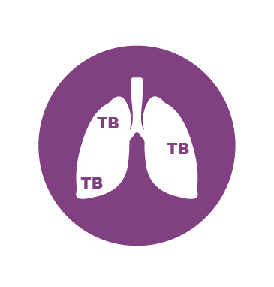
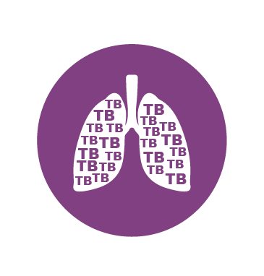
Two TB-Related Conditions
TB Infection
People with “latent TB infection (LTBI)” or “inactive TB”
  Do not feel sick, do not have symptoms, and cannot spread TB germs to others
  Can have inactive TB for years
  Have a small amount of TB germs in their bodies that are alive but inactive
TB infection can develop into TB disease at some point
  10% lifetime if normal immune system (5% in 1st 2y after infection
  10% PER YEAR if untreated HIV; higher with all immune dysfunction
TB Disease
If TB germs become active and multiply, TB infection can turn into TB disease
https://www.cdc.gov/tb/communication-resources/introduction-to-tuberculosis-slide-set.html
Notes:
Not everyone infected with TB germs becomes sick. As a result, two TB-related conditions exist: inactive TB (sometimes called latent TB, or LTBI) and TB disease.
TB germs can live in the body without making you sick. This is called inactive TB. People with inactive TB have TB germs in their bodies, but do not have TB disease and cannot spread the infection to other people.
TB germs become active if the immune system can’t stop them from growing. When TB germs are active (multiplying in your body), this is called TB disease.
On this slide, the lung with inactive TB (top) has a small amount of TB due to the immune system controlling the germs. The lung with TB disease (bottom) is full of TB because the immune system cannot stop the TB germs from growing and multiplying.
For more information: https://www.cdc.gov/tb/about/inactive-tuberculosis.html

Slide 7
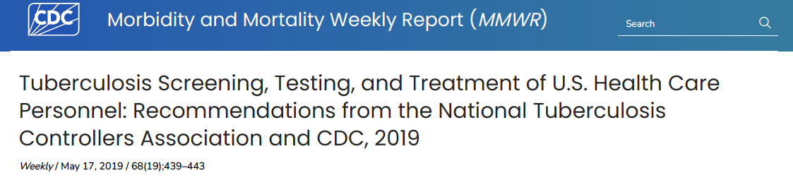

Individual baseline (pre-testing) risk assessment for all HCP at hire
TB symptom evaluation and baseline testing (IGRA or TST) of persons without prior TB disease or infection
No routine serial TB testing in the absence of exposure or ongoing transmission
Treatment for HCP diagnosed with TB infection, annual symptom screening for persons with untreated TB infection
Annual TB education of all HCP
http://dx.doi.org/10.15585/mmwr.mm6819a3

Slide 8
Advantages of IGRAs Over TST for TB Screening
IGRA (QFT-Plus, T-spot) | TB Skin Test
Single patient visit | Two visits (place and read test); loss to follow up
Results reported in 24h | Results read at 48-72h
Quantitative values not subjective; not affected by placement or reader skill | Human error possible in placement and interpretation
No boosting with subsequent IGRAs | Serial testing requires 2 step test to assess boosting.
Eliminates false + due to BCG and most NTM | Results affected by BCG vaccine and NTM
Results affected by immune dysfunction, but QFT-plus mitogen value can indicate immune function | Like IGRAs, TST are affected by immune status (HIV, age, other conditions/treatments)
Electronic results (may upload straight to EMR) | Manual recording of results-no standard place for documentation
Notes:
There are advantages and limitations to using IGRAs. Below are some advantages to using an IGRA compared to using the TST (Table 3.4).
z Requires a single patient visit to conduct the test
z Results can be available within 24 hours
z Does not cause the booster phenomenon which can happen with repeat TSTs
z Previous BCG vaccination does not cause a false-positive result
An advantage of using an IGRA compared to the TST is that it only requires one patient visit to conduct the test and results can be available within 24 hours. The TST requires two visits by the patient to obtain test results. The patient must come for their frst visit to receive the TST and then for a second visit, 48 to 72 hours later, to have their TST reaction read.
IGRA results can be available in 24 hours.
Since IGRAs are blood tests conducted in a laboratory, the patient is not exposed to the antigens. Thus, unlike the TST, there is no booster phenomenon when using an IGRA. Since IGRAs do not cause the booster phenomenon, there is no need to use two-step testing. (The booster phenomenon and two-step testing are discussed in the TB Testing Program section of this module.)
IGRAs do not cause the booster phenomenon.
The antigens used in IGRAs are not found in the BCG vaccine strains. Therefore, previous vaccination with BCG will not cause false-positive results when using an IGRA.
BCG vaccination does not afect IGRA results

Slide 9
Treatment of Persons with LTBI
(TB Infection, Inactive TB)

Slide 10
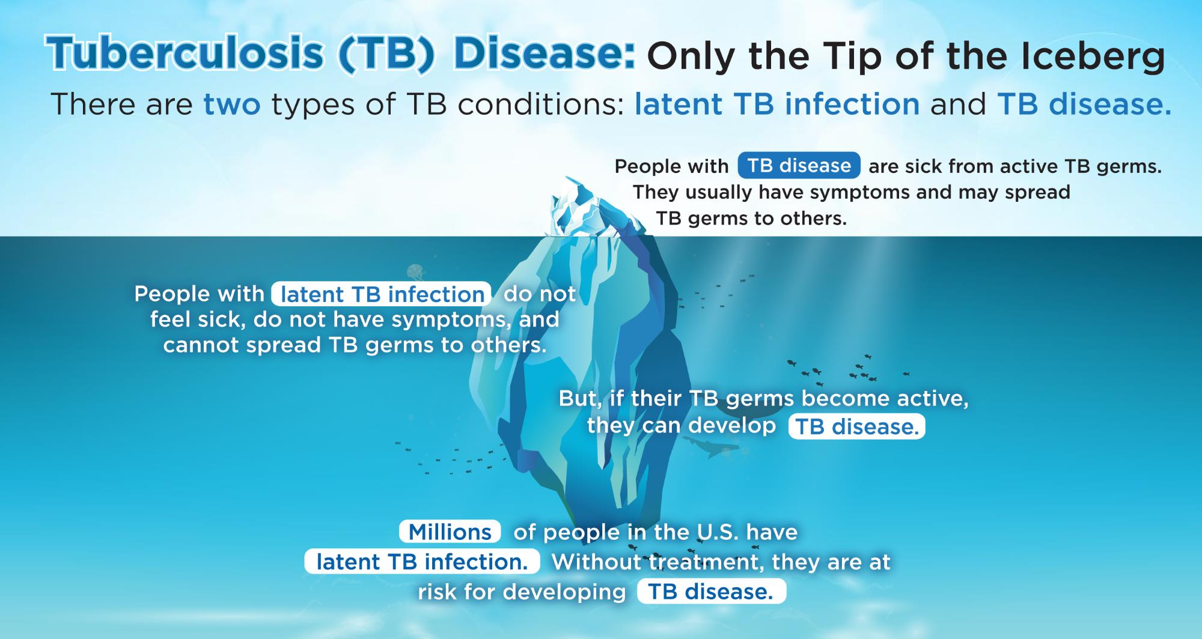
Tuberculosis (TB) Disease: Only the Tip of the Iceburg
There are two types of TB conditions: latent TB infection and TB disease.
People with TB disease are sick from active TB germs. They usually have symptoms and may spread TB germs to others.
People with latent TB infection do not feel sick, do not have symptoms, and cannot spread TB germs to others.
But, if their TB germs become active, they can develop TB disease.
Millions of people in the U.S. have latent TB infection Without treatment, they are at risk for developing TB disease.
Notes:
This graphic helps summarize TB disease and inactive TB (also called latent TB infection, or LTBI) in the United States. TB disease is just the tip of the iceberg that is visible above the water. TB disease can be seen because of the active germs in a person’s body and the symptoms they experience. People with TB disease can spread TB to others.
However, the larger part of the iceberg that is hidden underwater represents inactive TB. Like the iceberg, inactive TB can be easily hidden because TB germs are inactive and people with inactive TB germs do not feel sick. Many people with inactive TB do not know they are infected with TB. There are up to 13 million people in the U.S. with inactive TB. Without treatment for inactive TB, they could develop TB disease.

Slide 11
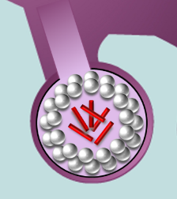
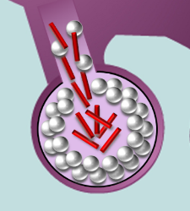
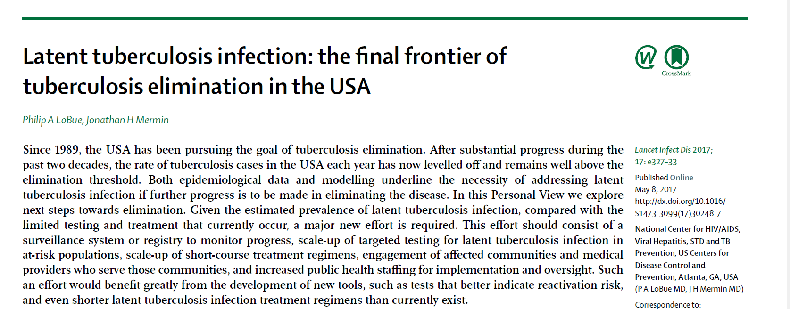
The U.S. Priority on Latent TB Infection (LTBI)
Lancet Infect Dis 2017; 17: e327–33

Slide 12
Polling Question #1
Module Q 4.1 Which statement is true about the purpose of LTBI treatment?
It is given to people who have LTBI to prevent them from testing positive on future tests for TB infection
It is given to people who have LTBI to prevent them from developing TB disease
It is given to people who have TB disease to prevent the disease from getting worse
It is given to people who have TB disease to prevent them from becoming infectious

Slide 13




Treatment for Inactive TB (LTBI)
People with inactive TB Should take medicine to prevent the development of TB disease, even though they don’t feel sick.
Compared to treatment for TB disease, inactive TB treatment
Is shorter
Is less costly
Has fewer side effects
Notes:
Treating inactive TB is effective in preventing TB disease. There are several options for the treatment of inactive TB. There have been advances in shortening the length of inactive TB infection treatment from 6–9 months to 3–4 months. Short-course inactive TB treatments are effective, safe, and have higher completion rates than longer treatments. Shorter regimens help patients finish treatment.
For more information: https://www.cdc.gov/tb/hcp/education/latent-tb-infection-recommendations-summary.html

Slide 14
Decision to Treat LTBI

Slide 15
Steps in LTBI Treatment Initiation
Decision whether LTBI treatment is indicated
  Has TB disease been ruled out?
  Do the benefits outweigh potential risks?
Patient education
Baseline laboratory tests
Selection of treatment regimen
Interventions for treatment completion challenges

Slide 16
Deciding to Treat for LTBI
Don’t start LTBI treatment until TB disease has been excluded by:
  Symptoms of pulmonary or extrapulmonary TB
  Prior history of TB or LTBI treatment
  Physical exam
  CXR
  When indicated, bacteriologic studies
Notes:
Another reason for the medical evaluation is to fnd out whether the patient has other medical problems that may complicate therapy or require more careful monitoring during therapy. These patients include:
z People living with HIV
z People with a history of liver disorder or disease
z People who use alcohol regularly
z Women who are pregnant or just had a baby (within 3 months of delivery)
z People who are taking other medications that may increase the risk of hepatitis For these patients, baseline laboratory liver function tests are recommended before starting LTBI treatment.
It is also important to fnd out if the patient has ever had any adverse reactions to drugs used for LTBI treatment or if they are currently on medications that may interact with LTBI treatment medications.

Slide 17
Medical Evaluation Before LTBI Treatment
Assess patient for other medical problems that may complicate therapy or require more careful monitoring during therapy.
  Co-infection with HIV
  History of liver disorder or disease
  Regular alcohol use/abuse
  Pregnant or just had a baby (within 3 months of delivery)
  Taking other medications that may increase the risk of hepatitis.
Ask if patient has ever had an adverse reaction to drugs used for LTBI therapy
Review all medications that may interact with LTBI treatment medications
  Prescribed, over the counter, herbal/supplements, etc.
If HIV status unknown, recommend HIV testing and counseling.

Slide 18
Medical Evaluation Before LTBI Treatment
Allows health care providers to build and establish rapport with patients.
Shared decision-making: clinician and patient should consider:
  Patient’s risk of developing active TB disease
  Risk for drug toxicity
  Patient's willingness to accept treatment
  Preferred LTBI regimen
  Patient's likely adherence and follow up plan
For some patients, the risks of adverse effects or drug-drug interactions may outweigh the risk of progression to TB disease if untreated.
* Note that treatment of LTBI is not required for U.S. immigration
Notes:
From risk of TB exposure or risk of progression to active TB

Slide 19
Polling Question #2
Which of the following are reasons why patients should receive a medical evaluation before starting LTBI treatment?
  Exclude the possibility of TB disease
  Determine whether they have ever been treated for TB infection or disease in past
  Identify any medical problems that may complicate therapy or require more careful monitoring
  Establish and build rapport with patient
  All of the above

Slide 20
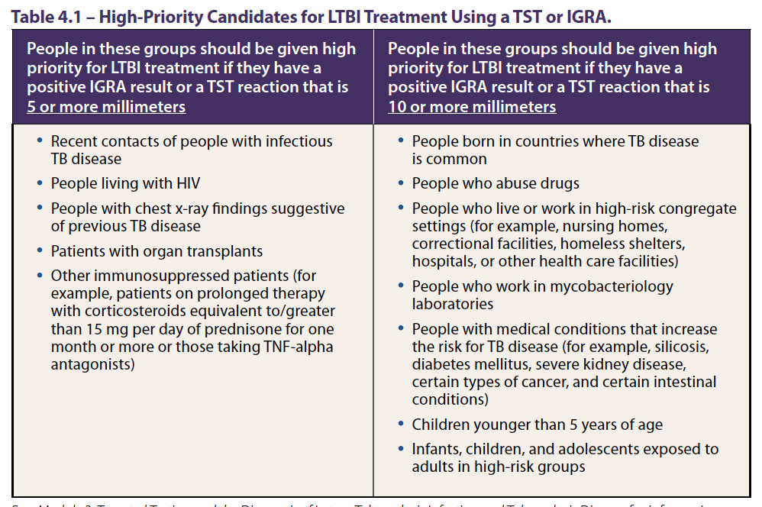

Slide 21
Patients Who Can be Considered for LTBI Treatment
Adults and Children with LTBI:
  Once TB disease is ruled out
Vulnerable contacts to active TB
  Immunosuppressed close contacts, regardless of negative result of TST/IGRA
  Children <5 years old exposed to pulmonary TB (repeat TST or IGRA at 8 weeks after exposure, stop treatment if negative) “window” prophylaxis
* Note that treatment of LTBI is not required for U.S. immigration
Notes:
TB disease should be excluded before starting LTBI treatment.

Slide 22
Infants and Young Children: Window Prophylaxis
Young children who are close contacts to someone with infectious TB should receive treatment for LTBI even if the TST result is negative and once TB disease is excluded by chest radiograph and symptom review. This is called “window“ prophylaxis.
A second TST should be administered 8 to 10 weeks after the last exposure to infectious TB.
Window prophylaxis can be discontinued if all of the following conditions are met:
  The infant is at least 6 months of age
  The second TST result is also negative and
  The second TST was performed at least 8 weeks after the child was last exposed to an adult with infectious TB disease

Slide 23
Treatment Regimens for LTBI

Slide 24
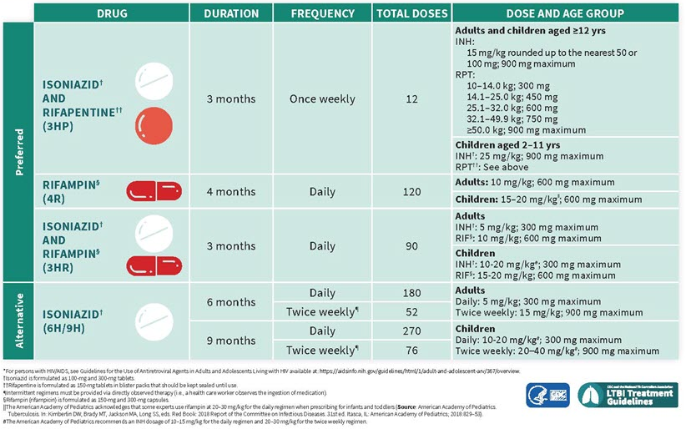
U.S. CDC Guidelines for the Treatment of LTBI, 2020
CDC, 2020, https://www.cdc.gov/mmwr/volumes/69/rr/rr6901a1.htm?s_cid=rr6901a1_w
Notes:
These updated 2020 LTBI treatment guidelines include the NTCA- and CDC-recommended treatment regimens that comprise three preferred rifamycin-based regimens and two alternative monotherapy regimens with daily isoniazid.

Slide 25
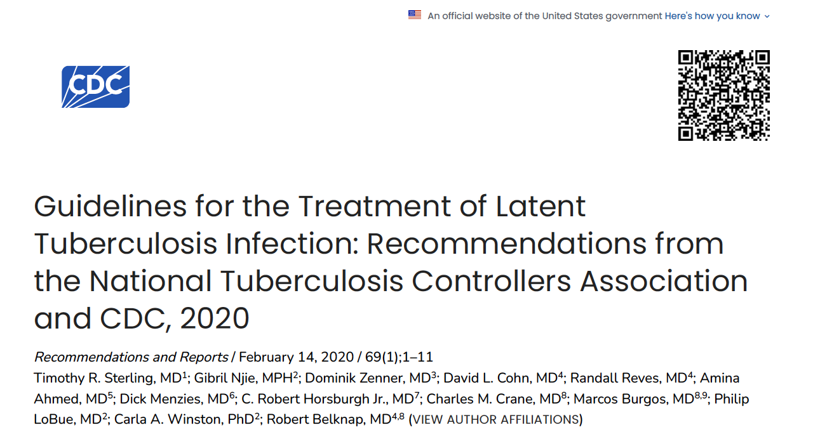
Summary of Evidence and Recommendations
There are 3 preferred Rifamycin-based regimens based on high effectiveness, safety and Tx completion rates:
  3 months of once-weekly isoniazid plus rifapentine (3HP)
  4 months of daily rifampin (4R)
  3 months of daily INH plus RIF (3HR)
https://www.cdc.gov/mmwr/volumes/69/rr/rr6901a1.htm
Notes:
Systematic Evidence review, The overall quality of evidence was appraised using the GRADE approach, recommendations
These updated 2020 LTBI treatment guidelines include the NTCA- and CDC recommended treatment regimens that comprise three preferred rifamycin-based regimens and two alternative monotherapy regimens with daily isoniazid. All recommended treatment regimens are intended for persons infected with Mycobacterium tuberculosis that is presumed to be susceptible to isoniazid or rifampin. These updated guidelines do not apply when evidence is available that the infecting M. tuberculosis strain is resistant to both isoniazid and rifampin; recommendations for treating contacts exposed to multidrug-resistant tuberculosis
were published in 2019 (Nahid P, Mase SR Migliori GB, et al. Treatment of drug-resistant tuberculosis. An official ATS/CDC/ERS/IDSA clinical practice guideline. Am J Respir Crit Care Med 2019;200:e93–e142). The three rifamycin-based preferred regimens are 3 months of once-weekly isoniazid plus rifapentine, 4 months of daily
rifampin, or 3 months of daily isoniazid plus rifampin. Prescribing providers or
pharmacists who are unfamiliar with rifampin and rifapentine might confuse the two
drugs. They are not interchangeable, and caution should be taken to ensure that
patients receive the correct medication for the intended regimen. Preference for these
rifamycin-based regimens was made on the basis of effectiveness, safety, and high
treatment completion rates. The two alternative treatment regimens are daily
isoniazid for 6 or 9 months; isoniazid monotherapy is efficacious but has higher
toxicity risk and lower treatment completion rates than shorter rifamycin-based
regimens.
In summary, short-course (3- to 4-month) rifamycin-based treatment regimens are
preferred over longer-course (6–9 month) isoniazid monotherapy for treatment of
LTBI. These updated guidelines can be used by clinicians, public health officials,
policymakers, health care organizations, and other state and local stakeholders who
might need to adapt them to fit individual clinical circumstances.

Slide 26
Summary of Evidence and Recommendations
There are 2 alternative INH regimens:
  9 months of daily INH (9H)
  6 months of daily INH (6H)
  9H better than 6H
While INH prevents TB, but higher toxicity risk and lower treatment completion rates decrease effectiveness of 6-9 months of INH.
https://www.cdc.gov/mmwr/volumes/69/rr/rr6901a1.htm
Notes:
Systemmatic Evidence review, The overall quality of evidence was appraised using the GRADE approach, recommendations
These updated 2020 LTBI treatment guidelines include the NTCA- and CDC recommended treatment regimens that comprise three preferred rifamycin-based regimens and two alternative monotherapy regimens with daily isoniazid. All recommended treatment regimens are intended for persons infected with Mycobacterium tuberculosis that is presumed to be susceptible to isoniazid or rifampin. These updated guidelines do not apply when evidence is available that the infecting M. tuberculosis strain is resistant to both isoniazid and rifampin; recommendations for treating contacts exposed to multidrug-resistant tuberculosis
were published in 2019 (Nahid P, Mase SR Migliori GB, et al. Treatment of drug-resistant tuberculosis. An official ATS/CDC/ERS/IDSA clinical practice guideline. Am J Respir Crit Care Med 2019;200:e93–e142). The three rifamycin-based preferred regimens are 3 months of once-weekly isoniazid plus rifapentine, 4 months of daily
rifampin, or 3 months of daily isoniazid plus rifampin. Prescribing providers or
pharmacists who are unfamiliar with rifampin and rifapentine might confuse the two
drugs. They are not interchangeable, and caution should be taken to ensure that
patients receive the correct medication for the intended regimen. Preference for these
rifamycin-based regimens was made on the basis of effectiveness, safety, and high
treatment completion rates. The two alternative treatment regimens are daily
isoniazid for 6 or 9 months; isoniazid monotherapy is efficacious but has higher
toxicity risk and lower treatment completion rates than shorter rifamycin-based
regimens.
In summary, short-course (3- to 4-month) rifamycin-based treatment regimens are
preferred over longer-course (6–9 month) isoniazid monotherapy for treatment of
LTBI. These updated guidelines can be used by clinicians, public health officials,
policymakers, health care organizations, and other state and local stakeholders who
might need to adapt them to fit individual clinical circumstances.

Slide 27
12-Dose (3 Month) INH-Rifapentine Regimen
3HP regimen: combination of isoniazid (INH) and rifapentine (RPT) given in 12 once-weekly doses
Can be considered for treating LTBI in:
  Healthy patients 2 years of age or older*
  Including persons living with HIV/AIDS on antiretroviral medications with acceptable drug-drug interactions with rifapentine
  Specific groups when it offers practical advantages, such as completion of treatment within a limited time frame
*Extensive published and unpublished experience with 3HP in children has demonstrated 3HP is safe, well tolerated, and at least as efficacious as 9H daily, although the pill burden in younger children is substantial and sometimes not well tolerated.

Slide 28
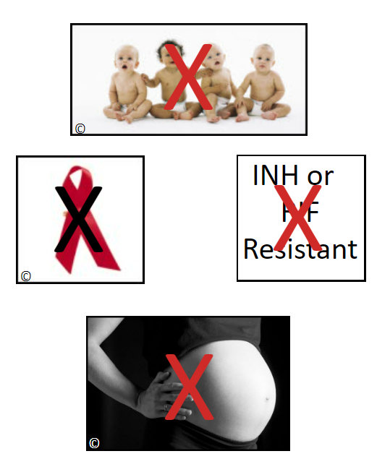
Recommendations for 12-Dose Regimen
The 3HP regimen is NOT recommended for
Children younger than 2 years*
Patients with presumed INH or RIF-resistant M. tuberculosis
Pregnant women
Women expecting to be pregnant within the treatment period
3HP should not be used in children <2 years of age because of a lack of pharmacokinetic data in this age group.

Slide 29
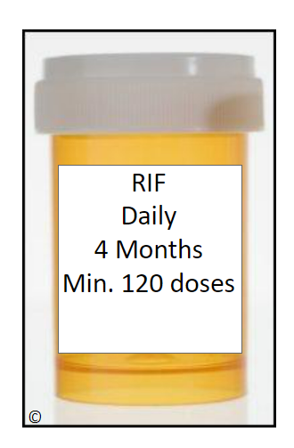
Rifampin Monotherapy (4R)
600mg po daily x 4 months
Very effective against “persister” organisms that are not actively replicating, shortens treatment
Can use in children of any age
Many drug interactions: HIV treatment, coumadin, steroids, OCPs, etc.
  Rifabutin can be substituted (300mg daily)
Caution to rule out sub-clinical TB, esp. patients with immunosuppression
Less hepatotoxicity than INH
Cost higher than INH, but overall cost-effective

Slide 30
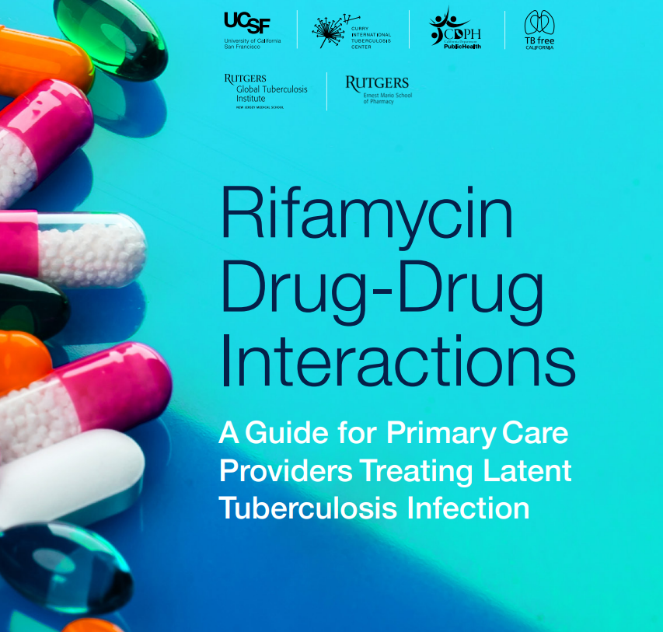
Rifamycin Drug-Drug Interactions
Use an online drug interaction checker or this reference:
Rifapentine has similar drug-drug interactions to Rifampin.
Unclear how much impact rifapentine once weekly has “ramping up” metabolism of most drugs.
  Some HIV drug interactions studied
Rifabutin daily can be substituted for rifampin
  Dose and drug-interactions are different
  Rifabutin can be affected by some drugs
Rifabutin cannot be substituted for rifapentine
https://www.currytbcenter.ucsf.edu/sites/default/files/2022-12/Rifamycin_2022.pdf
Notes:
Ample resources are available to help with management of drug-drug interactions

Slide 31
Rifamycins – Drug Interactions
Oral anticoagulants
Oral contraceptives
Cyclosporine
Glucocorticoids
Itraconazole
Ketoconazole
Methadone
Midazolam or triazolam
Phenytoin
Quinidine
Theophylline
Verapamil
β-Adrenergic blocking agents
Chloramphenicol
Clarithromycin
Dapsone
Diazepam
Digoxin (oral)
Diltiazem
Disopyramide
Doxycycline
Fluconazole
Haloperidol
Losartan potassium
Nifedipine
Nortriptyline
Sulfonylureas
Tacrolimus
Tocainide
Rifamycin Drug-Drug Interactions: A Guide for Primary Care Providers Treating Latent Tuberculosis Infection | Curry International Tuberculosis Center (ucsf.edu)

Slide 32
Isoniazid 6 to 9 Month Regimen (6 – 9H)
9-month regimen >> 6-month regimen
Active vs M.tb cell wall, only kills replicating organisms so it takes longer to eradicate TB infection
Treatment completion is poor with 6-9 months of treatment
INH can be given daily (or 2 times a week by DOPT)
Potential AEs: Liver toxicity, neurologic symptoms, some drug interactions
Not recommended for children, immunosuppressed persons, or those with evidence of previous TB on chest radiograph.

Slide 33
Polling Question #3
Which one of the regimens below is NOT approved for the treatment of LTBI.
  Isoniazid and rifapentine once a week for 12 weeks
  Rifampin and pyrazinamide for 2 months
  Rifampin for 4 months
  Isoniazid for 9 months
  Isoniazid for 6 months

Slide 34
Even Shorter LTBI Treatment Regimens …
Brief Rifapentine-Isoniazid Evaluation for TB Prevention (BRIEF TB)
Phase 3 clinical trial evaluated 1 month of daily rifapentine plus isoniazid (1HP) versus 9 months of daily isoniazid (9H) in people with HIV in mostly high TB burden settings (TB incidence >60 per 100,000)
1HP was non-inferior to 9H when comparing the composite outcome of confirmed or probable TB, death due to TB, and death due to unknown cause
Cited by U.S. NIH/CDC/HIVMA/IDSA Guidelines, 2022
  Isoniazid 300 mg PO daily plus rifapentine 300mg-600 mg PO daily plus pyridoxine 25–50 mg PO daily for 4 weeks is an alternative therapy for treatment of LTBI in people with HIV
A few U.S. programs have implemented this in non-HIV individuals

Slide 35
Even Shorter LTBI Treatment Regimens …
Assessment of the Safety, Tolerability, and Effectiveness of Rifapentine Given Daily for LTBI (ASTERoiD)
Currently enrolling
Sponsored by U.S. CDC
Open label, multi-center, phase 3 randomized controlled non-inferiority trial, both HIV and non-HIV participants
Comparing safety and effectiveness of a 6-week regimen of daily rifapentine against the current standard of 12-16 weeks of rifamycin-based treatment for latent TB infection
Estimated trial completion 2028

Slide 36
Monitoring During LTBI Treatment

Slide 37
Management of Patients During LTBI Treatment
Periodic Assessment
Clinical Monitoring
Laboratory Monitoring
Interventions for Treatment Completion Challenges
Management of Adverse Effects
Management of Treatment Interruption
Follow-up after Treatment Completion

Slide 38
Clinical Monitoring During LTBI Treatment
All persons receiving LTBI treatment should be evaluated at least monthly during therapy for:
  Adherence to the prescribed regimen
  Signs and symptoms of TB disease
  Adverse reactions (such as signs and symptoms of hepatitis)
Notes:
All persons receiving LTBI treatment should be evaluated at least monthly during therapy for:
Adherence to the prescribed regimen
Signs and symptoms of TB disease
Adverse reactions (such as signs and symptoms of hepatitis)
During each monthly evaluation, patients should be asked whether they have nausea, abdominal pain, or any of the other symptoms that may be caused by adverse reactions.
In addition, health care workers should examine patients for signs of these adverse reactions.
Patients should be instructed to stop taking medications and contact their health care provider immediately if they have any signs or symptoms of hepatitis (Table 4.4) or other severe adverse reactions.

Slide 39
Clinical Monitoring During LTBI Treatment
Page 14 of 22
Adverse Reactions to LTBI Treatment
The medicines used to treat LTBI can sometimes cause negative side effects.
Patients should be instructed to stop medications and contact a health care worker immediately if they have symptoms of a serious adverse reaction.
Dizziness or lightheadedness Loss of appetite Flu-like symptoms Severe diarrhea or light-colored stools Shortness of breath Feelings of sadness or depression Fever Unexplained weight loss Brown urine (color of coffee or cola) Yellowish skin or eyes | Rash Persistent tingling or prickling sensation of hands and feet Persistent tiredness or weakness lasting 3 or more days Stomach pain Easy bruising or bleeding Joint pain Nausea Vomiting

Slide 40
Clinical Monitoring During LTBI Treatment
Both INH and Rifamycins (rifampin, rifapentine, rifabutin) can cause liver toxicity
  INH hepatotoxicity is more common than RIF (transaminitis)
  10% to 20% of people treated with INH will have mildly elevated liver enzymes results during treatment; in most cases test results return to normal.
  Rifampin more likely to cause cholestasis pattern/elevated bilirubin
Hepatitis symptoms include:
  Nausea
  Vomiting
  Abdominal pain
  Fatigue
  Brown urine (normal orange-red discoloration of body fluids caused by rifampin is not hepatitis).

Slide 41
Baseline Labs Prior to LTBI Treatment
HIV testing for all patients who do not know status
Most patients do NOT need baseline labs
Obtain baseline liver function (AST, ALT) and CBC for patients who:
  Have HIV infection
  Use daily or heavy alcohol, or have liver disease or chronic hepatitis
  Are pregnant and postpartum patients (up to 2 to 3 months after delivery)
  Are currently injecting drugs
  Take other potentially hepatotoxic medications
  Have prior elevated AST/ALT
  Have hematologic conditions
Other labs as indicated (viral hepatitis serology, pregnancy test, etc.)
AST=aspartate aminotransferase; ALT=alanine aminotransferase ; CBC=complete blood count
Notes:
In general, baseline laboratory testing is not recommended unless the person is at high risk for hepatitis. People at greatest risk for hepatitis should have baseline liver function tests before starting LTBI treatment and during therapy. This includes:
People living with HIV
People with a history of liver disorder or disease
People who drink alcohol regularly
Women who are pregnant or just had a baby (within 3 months of delivery)
People who are taking other medications that may increase the risk of hepatitis

Slide 42
Follow Up Lab Monitoring During LTBI Treatment
Obtain follow-up tests monthly (or more frequently when clinically indicated) for patients with the following:
  Abnormal prior transaminase results
  Symptoms or signs suggestive of drug-induced hepatotoxicity
  Inability to give a reliable history for the absence of symptoms of hepatotoxicity
  Continued heavy or daily alcohol use, regardless of symptoms
Additional laboratory testing should be performed as clinically indicated to evaluate for other potential adverse effects related to LTBI treatment
For all patients, INH, rifampin, or rifapentine should be stopped if:
  Results of liver function tests are 3 times higher than the upper limit of the normal(ULN) range and the patient has symptoms, or
  Results are 5 times higher than ULN and the patient is asymptomatic.

Slide 43
Polling Question #4
Which of the following patients does NOT need liver testing before starting LTBI treatment?
  People living with HIV
  People with a history of liver disorder or disease
  People who drink alcohol regularly
  Women who are pregnant or just had a baby (within the last 3 months)
  People who are taking birth control pills

Slide 44
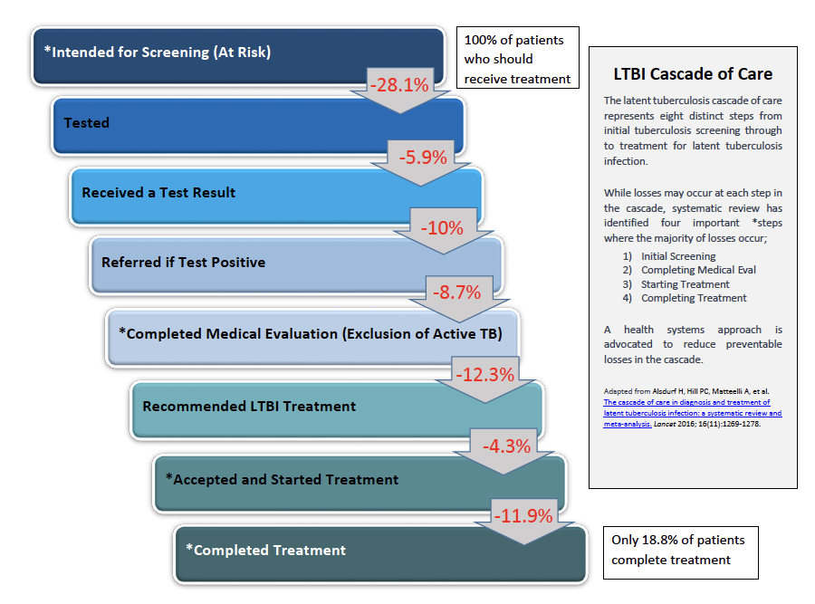
LTBI Cascade of Care

Slide 45
LTBI Treatment Completion
Completion= total number of doses + duration
If a patient misses multiple doses of LTBI Tx:
  Extend or re-start treatment if interruptions frequent or prolonged
  If interrupted >2 months, re-examine patient to rule out TB disease
  Recommend and arrange for DOT as needed

Slide 46
Treatment Completion for LTBI Treatment
Name | Drug(s) | Duration | Interval | Minimum doses for completion
3HP | Isoniazid & Rifapentine | 3 mo. | Once weekly | 12 within 16 weeks
4R | Rifampin | 4 mo. | Daily | 120 within 6 months
3HR | Isoniazid & Rifampin | 3 mo. | Daily | 90 within 4 months
6-9H | Isoniazid | 9 mo. | Daily | 270 within 12 months
 |  |  | Twice weekly | 76 within 12 months
 |  | 6 mo. | Daily | 180 within 9 months
 |  |  | Twice weekly | 52 within 9 months
Notes:
Important to consider duration of therapy in months but also consider missed doses.
None of the treatment regimens is effective unless it is completed. The health care provider should ask the patient about practical challenges to treatment—for example, clinic access, work schedule, lack of transportation, homelessness, or substance use—and should learn about the patient’s perspective on LTBI and its treatment.
To address adherence barriers, consider one or more of the following interventions: prescribing a shorter treatment regimen, using directly observed or video directly observed therapy, providing incentives, ensuring enablers, and educating the patient.

Slide 47
Barriers to LTBI Treatment and Adherence
Patient Factors
Knowledge and Perception Barriers
  No symptoms: Patients feel completely healthy,a long preventive course feels unnecessary.
  Low awareness: Limited understanding LTBI and how treatment reduces the risk of active TB.
  Doubt: Questioning whether treatment works or if positive test is from prior BCG vaccine.
Physical and Treatment Factors
  Side effects: Fear or actual occurrence of nausea, fatigue, or liver irritation from the pills.
  Long duration: Regimens lasting 3 to 9 months are hard to maintain for asymptomatic people.
  Pill burden: Managing multiple daily or weekly medications alongside other health conditions.
Logistical and Social Challenges
  Financial costs: Expenses for clinic visits, missed wages from time off work, or medication costs.
  Transportation issues: Difficulty traveling to clinics or picking up refills regularly.
  Stigma and lack of support: Fear of being judged; lack of encouragement from family or peers.

Slide 48
Barriers to LTBI Treatment and Completion
Physician/Clinic Factors
Provider Knowledge and Comfort Levels
Knowledge gaps: Unfamiliarity with current guidelines regarding LTBI screening and preferred short-course rifamycin regimens versus older INH monotherapy.
Uncertainty in diagnosis: Confusion over interpreting TST or choosing appropriate IGRAs, especially in BCG-vaccinated patients.
Managing adverse effects: Hesitancy or lack of experience in monitoring and handling hepatotoxicity or drug-related side effects.
Clinic and Systemic Constraints
Time limitations: Short consultation windows make it difficult to deliver comprehensive patient education on asymptomatic infection and long-term adherence.
Resource shortages: Lack of dedicated staff or robust tracking systems for follow-up of positive tests, CXR results, treatment completion.
Specialist isolation: Poor communication channels or lack of timely back-up support from public health or infectious disease specialists for primary care providers.
Competing priorities: Clinical workflows prioritizing acute illness, chronic disease management, or active TB over preventive care for latent infections.
Medication shortages: varies by jurisdiction
Notes:
Providers not aware of importance of LTBI screening and treatment
Providers uncomfortable prescribing LTBI medication
Can’t easily identify who to follow up on (test or CXR results hard to flag)
No time to discuss LTBI in consults due to urgent conditions or tight scheduling
No workflow or procedure in place to follow up on LTBI
Cannot access medications due to shortages

Slide 49
Adherence to LTBI Treatment
Using shorter treatment regimens can help patients complete treatment.
Techniques to improve adherence include:
  Providing directly observed therapy (DOT) if the patient is high risk (for example, HIV infected, young child, or TB contact).
  Using case management principles to coordinate care and services.
  Considering free or low-cost medication.
  Offering rewards for adherence (incentives), such as grocery store or restaurant vouchers, nutritional supplements, cell phone credits, or movie tickets.
  Providing enablers to overcome barriers, such as free transportation or public transportation vouchers.
  Providing patient education and instructions in patient’s primary language at every visit.
  Ensuring confidentiality.
  Suggesting or providing patient reminders, such as pill box, calendar, or timer.

Slide 50
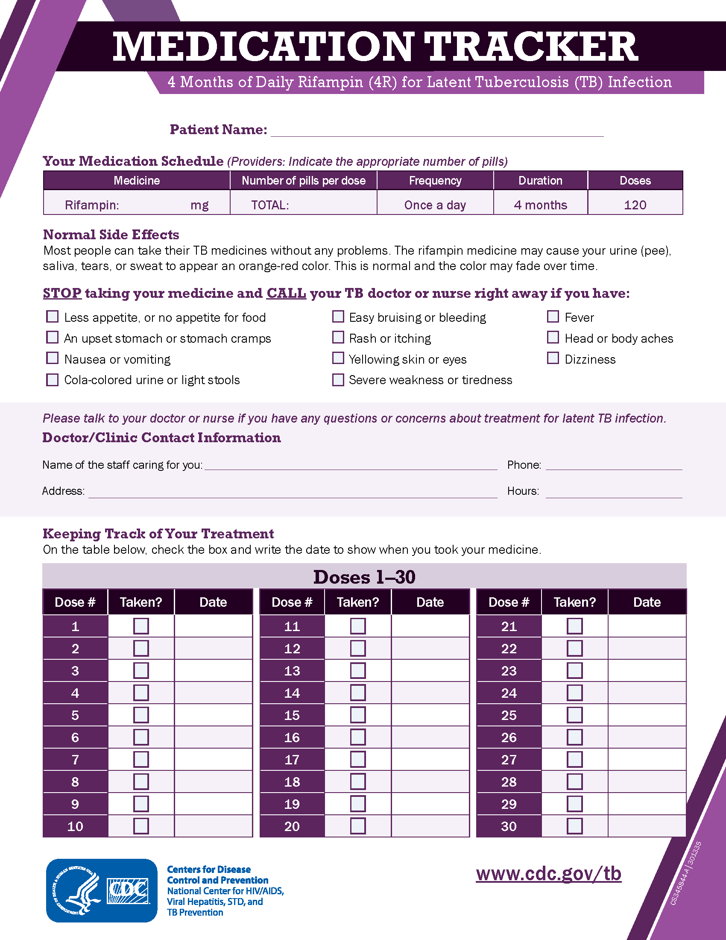
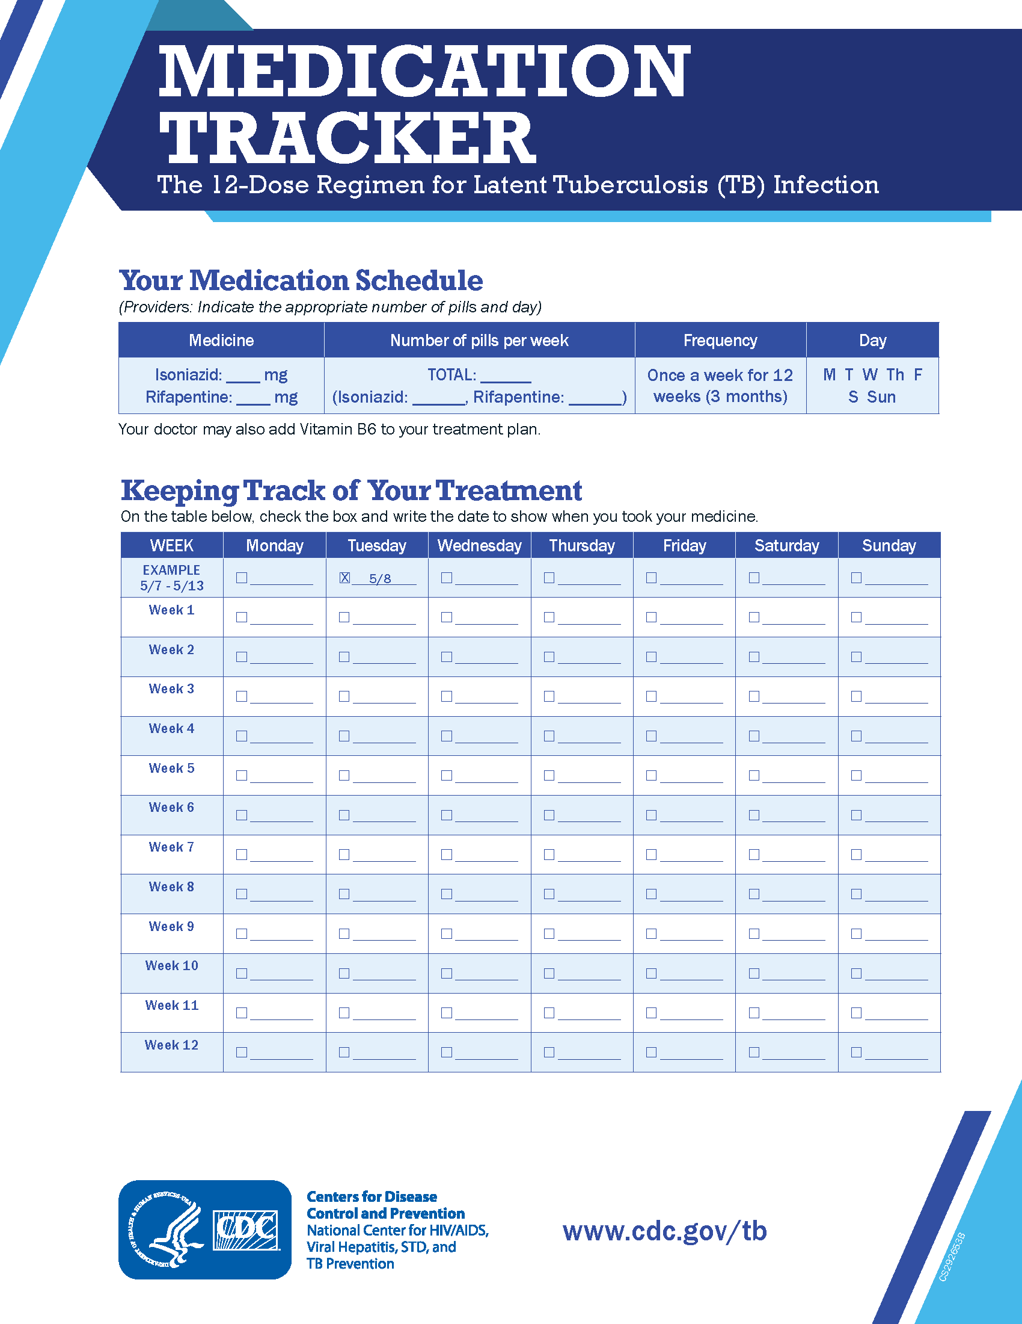
4R Regimen Medication Tracker
https://www.cdc.gov/tb/communication-resources/4r-medication-tracker.html
3HP Regimen Medication Tracker
https://www.cdc.gov/tb/communication-resources/3hp-medication-tracker.html

Slide 51
Treatment Follow-up
Patients should receive documentation of TST or IGRA results, regimens, and treatment completion dates.
The patient should be told to present this document any time they are required to be tested for TB.
Patients should also be re-educated about the signs and symptoms of TB disease.

Slide 52
Special Considerations for LTBI Treatment:
Contacts
“Contacts” are people exposed to someone with infectious TB disease.
Contacts should be quickly identified, located, assessed for TB disease vs LTBI.
Once TB disease is excluded, contacts are high priority for LTBI treatment.
If contact’s TST or IGRA is negative, he or she should be re-tested if it has been < 8 to 10 weeks after last exposure to infectious TB disease.
  It can take 2 to 8 weeks after M.tb infection for body’s immune system to mount a response detectable by the TST/IGRAs.
Contacts with a positive TST/IGRA and a documented history of LTBI treatment completion do not need to be retreated.
Retreatment may be necessary for persons at high risk of becoming re-infected and progressing to TB disease (for example, immunocompromised persons).
In complicated situations, a TB expert should be consulted.
Notes:
Contacts
Contacts are people who have been exposed to someone with infectious TB disease. Contacts should be quickly identifed, located, and assessed for TB disease and LTBI. If a contact’s TST or IGRA result is positive and TB disease is excluded, he or she should be considered high priority for LTBI treatment. If a contact’s TST or IGRA is negative, he or she should be retested if it has been less than 8 to 10 weeks after his or her last exposure to infectious TB disease. This is because it can take 2 to 8 weeks after being infected with
M. tuberculosis for the body’s immune system to mount a response detectable by the tests. If the result of the repeat test is positive, and TB disease is excluded, the contact should be classifed as recently infected and followed-up and treated appropriately.
In general, contacts with a positive TST or IGRA and a documented history of completion of LTBI treatment do not need to be retreated. However, retreatment may be necessary for persons who are at high risk of becoming re-infected and progressing to TB disease (for example, immunocompromised persons). In complicated situations, a TB expert should be consulted.

Slide 53
Special Considerations for LTBI Treatment:
High-Risk Contacts
Some contacts may start taking LTBI therapy if negative TST or IGRA result but <8 to 10 weeks since last TB exposure.
  Children <5 years of age (some TB programs have different age cutoff guidelines)
  People living with HIV
  Other immunosuppressed contacts (seek expert opinion)
Once TB disease is ruled out, these contacts should start LTBI treatment to prevent them from rapidly developing TB disease.
They also should be retested 8 to 10 weeks after they were last exposed to TB.
If contact has positive TST or IGRA result, he/she should continue to take LTBI tx.
Some TB contacts (i.e., severely immunosuppressed) may be given full LTBI treatment even if their second TST or IGRA result is negative.
  Immune system may not be able to mount reaction to test if infected (false-negative)
Notes:
Contacts at High Risk for Rapid Development of TB Disease
Sometimes LTBI treatment is given to people who have a negative TST or IGRA result. For example, some contacts at high risk for rapidly developing TB disease should start LTBI treatment even if they have a negative test and less than 8 to 10 weeks have passed since they were last exposed to TB. These contacts include
z Children who are younger than 5 years of age (some TB programs may have diferent age cutof guidelines) z People living with HIV
Some contacts may start taking LTBI treatment if they have a negative TST or IGRA result but less than 8 to 10 weeks have passed since they were last exposed to TB.
Once TB disease is ruled out, these contacts should start LTBI treatment to prevent them from rapidly developing TB disease. They also should be retested 8 to 10 weeks after they were last exposed to TB. If the contact has a positive TST or IGRA result, he or she should continue to take LTBI treatment. Contacts living with HIV may be given a full course of LTBI treatment even if their second TST or IGRA result is negative.
TB contacts living with HIV may be given a full course of LTBI treatment even if their second TST or IGRA result is negative.
Expert consultation should be sought to determine if contacts with immunocompromised states other than HIV infection (e.g., contacts taking immunosuppressive therapies, diabetic patients) could benefit from treatment even if they have a negative TST or IGRA result. Offering treatment for presumed M. tuberculosis infection may be considered if the likelihood of infection is high, based on the circumstances of the exposure and prevalence of TB infection among other contacts.

Slide 54
Special Considerations for LTBI Treatment:
Infants and Children
Because of their age, infants and young children with positive TB screening test must have been infected recently and are at high risk of rapidly developing TB ds.
  Also more likely to develop life-threatening forms of TB disease.
Once TB disease ruled out, children <5 years of age exposed to TB should receive LTBI treatment, even if they have a negative TST result.
  Children should be retested 8 to 10 weeks after they were last exposed to TB.
  They may have a false-negative TST reaction (immature immunity)
DOPT should be considered for children taking LTBI treatment.
Children <5 years of age should continue taking LTBI treatment until ALL of the following conditions are met:
  The child is at least 6 months of age
  The second TST is negative
  The second TST was done at least 8 weeks after child was last exposed to infectious person
Notes:
Infants and Children
Because of their age, infants and young children with a positive TST reaction must have been infected recently and are at high risk of rapidly developing TB disease. Infants and young children are also more likely than older children and adults to develop life-threatening forms of TB disease.
Once TB disease has been ruled out, children who are younger than 5 years of age who have been exposed to TB should receive LTBI treatment, even if they have a negative TST result. This is because they are at high risk of rapidly developing TB disease and because they may have a false-negative TST reaction (see Module 3, Targeted Testing and the Diagnosis of Latent Tuberculosis Infection and Tuberculosis Disease). Because they are at high risk for rapidly developing TB disease, DOT should be considered for children taking LTBI treatment. Children should be retested 8 to 10 weeks after they were last exposed to TB.
Children who are younger than 5 years of age and who have been exposed to TB should start taking LTBI treatment, even if they have a negative TST result.
Children younger than 5 years of age should continue taking LTBI treatment until ALL of the following conditions are met:
z The child is at least 6 months of age
z The second TST is negative
z The second TST was done at least 8 weeks after the child was last exposed to a person with
infectious TB disease

Slide 55
Special Considerations for LTBI Treatment:
Pregnant Women
Pregnant women can take any of the following regimens for LTBI treatment:
  4-month daily regimen of RIF (4R)
  3-month daily regimen of INH and RIF (3HR)
  6- or 9-month daily regimen of INH (6H or 9H)
Pregnant women taking isoniazid should also take vitamin B6 supplement.
3HP is not currently recommended for pregnant women or women expecting to become pregnant during the treatment regimen.
For most pregnant women with LTBI, treatment can be delayed until after delivery. If the woman does not have any risk factors for developing TB disease, treatment should be given after she has delivered her baby, so she can avoid having to take anti-TB medications during pregnancy.
For women in the post-partum period (within 3 months of delivery), baseline liver function tests should be conducted.
If the pregnant woman is a recent contact to a person with infectious TB disease, immediate treatment should be considered.

Slide 56
Special Considerations for LTBI Treatment:
Breastfeeding Women
Breastfeeding is not contraindicated for women taking INH or rifampin.
The amount of INH or rifampin found in breast milk is not harmful to infant.
Additionally, the concentration of drugs found in the breast milk is not considered effective treatment for the infant.
Breastfeeding women who are taking INH must be given vitamin B6.
Women who are taking rifampin may notice a normal orange discoloration of body fluids, including breast milk.
Currently, there is not enough data to indicate whether the 12-dose regimen of isoniazid and rifapentine (3HP) is safe for women to take while breastfeeding.
Notes:
Breastfeeding Women
Breastfeeding is not contraindicated for women taking isoniazid or rifampin. The amount of isoniazid or rifampin found in the breast milk is not harmful to the infant. Additionally, the concentration of drugs found in the breast milk is not considered efective treatment for the infant. Breastfeeding women who are taking isoniazid must be given a vitamin B6 supplement. Women who are taking rifampin may notice a normal orange discoloration of body fuids, including breast milk.
Currently, there is not enough data to indicate whether the 12-dose regimen of isoniazid and rifapentine is safe for women to take while breastfeeding.

Slide 57
Special Considerations for LTBI Treatment:
Contacts of Drug-Resistant TB
If contact of a patient with INH-resistant but rifampin-susceptible TB, a 4-month regimen of daily rifampin may be recommended.
  In situations where rifampin cannot be used, rifabutin may be substituted.
If a person is a contact with multidrug-resistant (MDR) TB (both INH and RIF resistant), the risk for developing TB disease should be considered before recommending LTBI treatment.
  Fluoroquinolones (Levo/Moxi) are recommended if TB is susceptible
  Treat 6 - 12 months or observe for signs and symptoms of disease without treatment.
  All persons with suspected MDR LTBI should be followed and observed for signs and symptoms of TB disease for 2 years, regardless of the treatment regimen.
  An expert in the treatment of MDR TB should also be consulted.
Notes:
Contacts of Isoniazid-Resistant TB
If a person is a contact of a patient with isoniazid-resistant but rifampin-susceptible TB, a 4-month regimen of daily rifampin may be recommended. In situations where rifampin cannot be used, rifabutin may be substituted.
Contacts of Multidrug-Resistant TB
If a person is a contact of a patient with multidrug-resistant (MDR) TB, the risk for developing TB disease should be considered before recommending LTBI treatment. MDR TB contacts may be treated for 6 to 12 months or they can be observed for signs and symptoms of disease without treatment.
If a person is a contact of a patient with MDR TB, the risk for developing TB disease should be considered before recommending LTBI treatment.

Slide 58
Special Considerations for LTBI Treatment:
HIV Infection
Preferred Drugs for Treatment of Latent Tuberculosis Infection
3HP: Weekly Isoniazid plus Rifapentine for 12 Weeks (AI)
  Note: only for virally-suppressed individuals receiving an efavirenz-, raltegravir-, or once-daily dolutegravir-based regimen (AII). RPT may lower concentrations of tenofovir alafenamide
3HR: Daily Isoniazid plus Rifampin for 3 Months (AI)
  Note: See Drug Interaction Tables in the Opportunistic Infections Guidelines for the list of ART not recommended for use with rifampin and those which require dosage adjustment
Alternative Drugs for Treatment of Latent Tuberculosis
6H/9H: Daily INH for 6 to 9 Months (AII)
4R: Daily Rifampin for 4 Months (BI)
    Note: See Opportunistic Infections Guidelines
  1HP: Daily Isoniazid plus Rifapentine for 1 Month (BI) (see OI guidelines)
Expert consultation should be sought for the care and treatment of HIV-infected persons who have LTBI.
https://clinicalinfo.hiv.gov/en/guidelines/hiv-clinical-guidelines-adult-and-adolescent-opportunistic-infections/mycobacterium
Notes:
It is very important that persons with both latent TB infection (LTBI) and HIV infection receive treatment coordinated in consultation with experts familiar with both HIV and TB. This is because a person with untreated LTBI and HIV infection is much more likely to develop TB disease during his or her lifetime than someone without HIV infection.
Rapid progression from LTBI to TB disease among people living with HIV/AIDS can almost always be prevented with appropriate treatment.
When treating persons with HIV/AIDS for latent TB infection, clinicians should review the guidelines for the use of antiretroviral agents in adults and adolescents living with HIV
People with HIV Infection
The 12-dose regimen of isoniazid and rifapentine is recommended for people with HIV infection who are taking antiretroviral medications that have acceptable drug-drug interactions with rifapentine, such as efavirenz and raltegravir. The 12-dose regimen of isoniazid and rifapentine is not recommended for people with HIV infection who are taking antiretroviral medications with clinically signifcant or unknown drug interactions with rifapentine.
People with HIV infection can also be treated with a 9-month regimen of isoniazid. For people with HIV infection who cannot tolerate isoniazid or who have been exposed to isoniazid-resistant
M. tuberculosis, an alternative treatment is 4 months of rifampin. However, rifampin should not be used for people with HIV who are being treated with certain combinations of ART. In these cases, dose-adjusted rifabutin may be given.
As new research occurs, guidelines may change. Expert consultation should be sought for the care and treatment of HIV-infected persons who have LTBI.

Slide 59
Polling Question #5
Which of the following LTBI treatment regimens may be recommended for people exposed to isoniazid-resistant TB? Select one.
  Isoniazid and rifapentine once a week for 12 weeks
  Rifampin daily for 4 months
  Rifapentine once a week for 6 months
  Ethambutol daily for 6 months

Slide 60
Polling Question #6
Module Q4.6 In which of the following circumstances may LTBI treatment be given to people who have a negative TST or IGRA result? Choose ONE
  Children who are 5 years of age or younger
  People living with HIV
  People taking a TNF-ɑ inhibitor (e.g., infliximab)
  All of the above
Notes:
Some contacts may start taking LTBI treatment even if they have a negative skin test and less than 8 to 10 weeks have passed since they were last exposed to TB.
These contacts include
Children who are 5 years of age or younger (some TB programs may have different age cutoff guidelines)
People living with HIV
Once TB disease is ruled out, these contacts should start LTBI treatment to prevent them from rapidly developing TB disease. They also should be retested 8 to 10 weeks after they were last exposed to TB. If the contact has a positive TST or IGRA result, he or she should continue to take LTBI treatment. Contacts living with HIV may be given a full course of LTBI treatment even if their second TST or IGRA result is negative.
Expert consultation should be sought to determine if contacts with immune impairments other than HIV infection (e.g., contacts taking immunosuppressive therapies) could beneft from treatment even if they have a negative TST or IGRA result. Ofering treatment for presumed M. tuberculosis infection may be considered if the likelihood of infection is high, based on the circumstances of the exposure and prevalence of TB infection among other contacts.

Slide 61
Questions
For questions about KY TB Program and Policies:
Tuberculosis@ky.gov

Slide 62
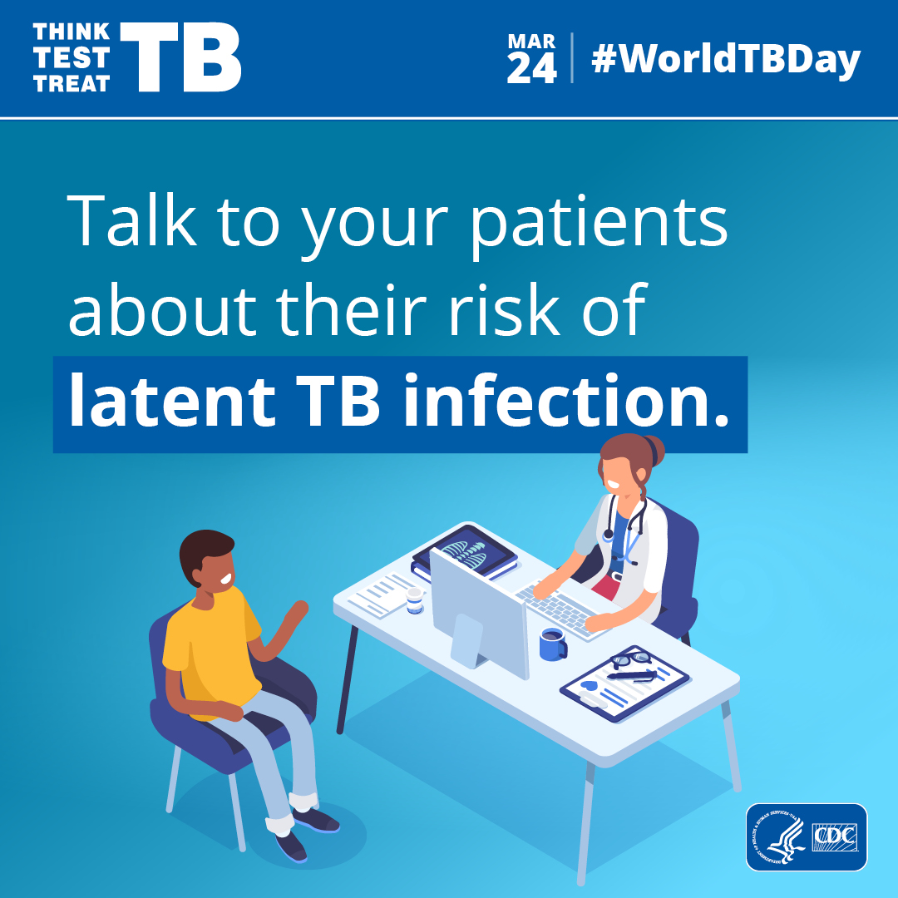
Think. Test.
Treat TB
CDC’s Think. Test. Treat TB campaign aims to reach those most at risk for inactive TB infection and their health care providers to encourage TB testing and get closer to the elimination of TB
Think. Test. Treat TB is the first national multilingual communications campaign to increase testing for inactive TB infection, a major health disparity among Asian Americans
Notes:
CDC’s Think. Test. Treat TB campaign aims to reach those most at risk for latent TB infection and their health care providers to encourage TB testing and get closer to the elimination of TB. Think. Test. Treat TB is the first national multilingual communications campaign to increase testing for inactive TB, a major health disparity among Asian Americans.
More information: https://www.cdc.gov/think-test-treat-tb/index.html

Slide 63
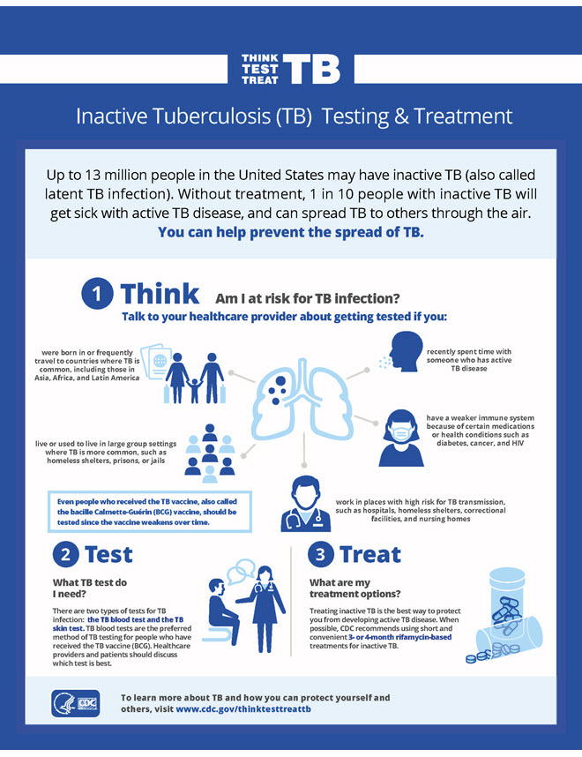

https://www.cdc.gov/think-test-treat-tb/index.html

Slide 64
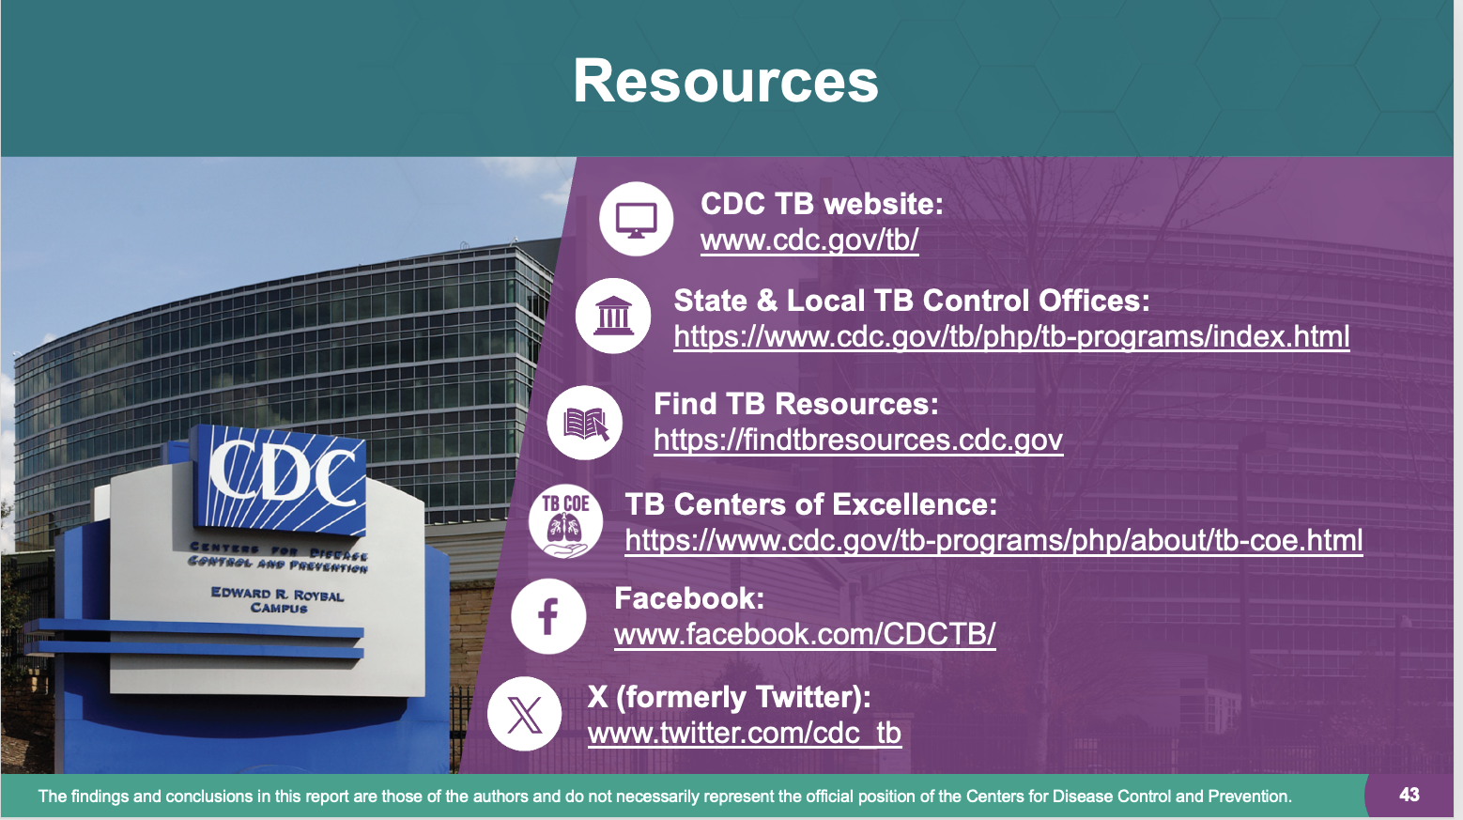






Resources
CDC TB website:
www.cdc.gov/tb/
State & Local TB Control Offices:
https://www.cdc.gov/tb/php/tb-programs/index.html
Find TB Resources:
https://findtbresources.cdc.gov
TB Centers of Excellence:
https://www.cdc.gov/tb-programs/php/about/tb-coe.html
Facebook: www.facebook.com/CDCTB/
X (formerly Twitter): www.twitter.com/cdc_tb
The findings and conclusions in this report are those of the authors and do not necessarily represent the official position of the Centers for Disease Control and Prevention.

Slide 65
Other Resources for Treatment of LTBI
Testing and Treatment of Latent Tuberculosis Infection in the United States: Clinical Recommendations https://www.tbcontrollers.org/docs/resources/tb-infection/LTBI_Clinical_Recommendations_Version_002052021.pdf

Slide 66

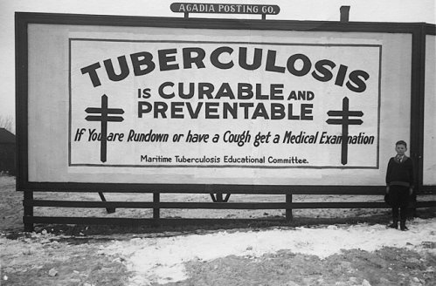
Questions and Discussions

Slide 67
NEXT TB LUNCH AND LEARN
Thursday, August 6
12-1pm EST
Week 6. Serial TB Testing Programs and Case Studies

Slide 68
Answers to Module Questions and Extra Slides

Slide 69
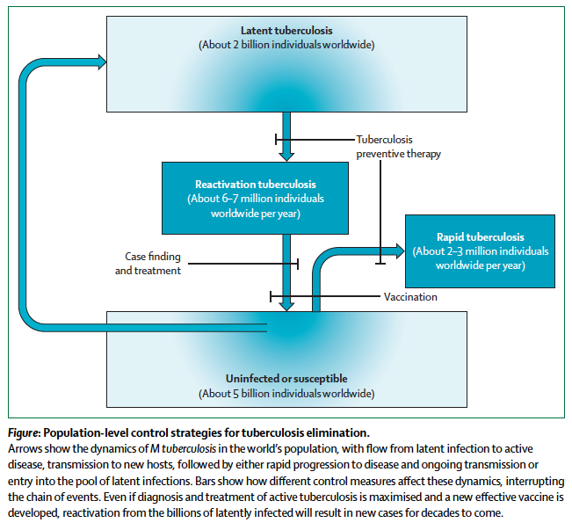
Notes:
How to eliminate tuberculosis 3. Controlling the seedbeds of tuberculosis: diagnosis and treatment of tuberculosis infection. Rangaka, Lancet Published Online October 26, 2015 http://dx.doi.org/10.1016/S0140-6736(15)00323-2.
Identification of high-risk epidemic locales (see Theron et al, paper 1)10 as well as intensification of case-finding and improvements in treatment (see Yuen et al, paper 2),11 although important, cannot alone achieve tuberculosis elimination because the reservoir of asymptomatically infected individuals will continue to produce millions of new cases of reactivation
tuberculosis for decades to come. Even a highly effective new vaccine that prevents disease after new infection would not be sufficient for eliminating tuberculosis because the high prevalence of existing infections would not be affected. Thus, epidemiologically sound tuberculosis elimination strategies should include treatment of tuberculosis infection to be effective.12
Because the human reservoir of M tuberculosis infection is enormous, overwhelmingly asymptomatic, and long-lived, a strategy to identify individuals who are at highest risk of
progression to disease, who would thus benefit the most from preventive therapy, is widely recommended.

Slide 70
Possible Isoniazid Adverse Events
Isoniazid can cause hepatitis in anyone; however, hepatitis occurs in less than 1% of people taking isoniazid. Many things can cause hepatitis, including various viruses and other medications. There are certain risk factors that increase the risk of serious isoniazid hepatitis, such as alcoholism and older age. Although rare, there have been some cases of severe and fatal hepatitis.
Some factors, such as older age and alcoholism, increase the risk that isoniazid will cause serious hepatitis.
Isoniazid can also damage the sensory nerves of the hands and feet. This is called peripheral neuropathy. The main symptom of peripheral neuropathy is a tingling sensation, a weakened sense of touch, or pain in the hands, palms, soles, and feet. Some conditions, such as HIV, alcoholism, diabetes, and malnutrition increase the risk for peripheral neuropathy. People with these conditions should be given vitamin B6.
Isoniazid can damage the sensory nerves of the hands and feet.

Slide 71
Possible Rifamycin Adverse Events
Patients taking either rifampin, rifapentine, or rifabutin should also be aware of possible adverse effects. Some infrequent side effects from these drugs can include:
  Rash
  Gastrointestinal symptoms (nausea, anorexia, and abdominal pain)
  Orange discoloration of body fluids (e.g., urine, saliva, tears, or breast milk); soft contact lenses may be permanently stained
  Interaction with many other drugs, such as birth control pills and implants, warfarin, some HIV drugs, and methadone
  Hypersensitivity
Rifapentine may also cause fu-like symptoms.
Rifabutin may cause:
  Eye inflammation
  Joint pain
  Lower white blood cell count
All persons taking LTBI treatment should be educated about the symptoms caused by adverse reactions.

Slide 72
Module Q4.2 Which groups of people should receive high priority for LTBI treatment if they have a positive IGRA result or a TST reaction with an induration that is 5 millimeters or larger? Name five.
  Recent contacts of people with infectious TB disease
  People living with HIV
  People with chest x-ray findings suggestive of previous TB disease
  Patients with organ transplants
  Other immunosuppressed patients (for example, patients on prolonged therapy with corticosteroids equivalent to/greater than 15 mg per day of prednisone or those taking TNF-alpha antagonists)

Slide 73
Module Q4.3 Which groups of people should receive high priority for LTBI treatment if they have a positive IGRA result or a TST reaction with an induration that is 10 millimeters or larger? Name seven.
People who have come to the U.S. from areas of the world where TB is common (for example, Asia, Africa, Eastern Europe, Russia, or Latin America)
People who abuse drugs
People who live or work in high-risk congregate settings (for example, nursing homes, correctional facilities, homeless shelters, hospitals, or other health care facilities)
People who work in mycobacteriology laboratories
People with medical conditions that increase the risk for TB disease (for example, silicosis, diabetes mellitus, severe kidney disease, certain types of cancer, and certain intestinal conditions)
Children younger than 5 years of age
Infants, children, and adolescents exposed to adults in high-risk groups

Slide 74
Module Q4.4 List the four regimens that are approved for the treatment of LTBI.
  Isoniazid and rifapentine once a week for 12 weeks
  Rifampin for 4 months
  Isoniazid for 9 months
  Isoniazid for 6 months

Slide 75
Module Q 4.5 What LTBI treatment regimen may be recommended for people with a positive TST or IGRA result who have been exposed to isoniazid-resistant TB? Select one.
Isoniazid and rifapentine once a week for 12 weeks
Rifampin daily for 4 months
Rifapentine once a week for 6 months
Ethambutol daily for 6 months

Slide 76
Module Q4.7 What conditions must be met to stop LTBI treatment for children who are 5 years old or younger and have been exposed to TB?
  Children 5 years and younger who have been exposed to TB should start taking LTBI treatment, even if they have a negative TST. Children should be retested 8 to 10 weeks after they were last exposed to TB. LTBI treatment can be stopped if all of the following conditions are met:
    The child is at least 6 months of age
    The second TST is negative
    The second TST was done at least 8 weeks after the child was last exposed to an adult with infectious TB disease

Slide 77
Module Q4.8 When should pregnant women be treated for LTBI and for how long?
  For most pregnant women with TB infection, LTBI treatment can be delayed until after delivery.
  If the pregnant woman is a recent contact or HIV-infected, immediate treatment should be considered.
  The preferred LTBI treatment regimen for pregnant women is 9 months of isoniazid with a vitamin B6 supplement.

Slide 78
Module Q4.9 Name four reasons why patients should receive a medical evaluation before starting LTBI treatment.
  All patients being considered for LTBI treatment should receive a medical evaluation in order to:
  Exclude the possibility of TB disease
  Determine whether they have ever been treated for TB infection or disease
  Identify any medical problems that may complicate therapy or require more careful monitoring
  Establish and build rapport with patient

Slide 79
4.10 Why is it important to exclude the possibility of TB disease before giving a patient LTBI treatment?
  It is important to exclude the possibility of TB disease because treating TB disease with a LTBI treatment regimen can lead to drug resistance.

Slide 80
4.11 Which of the following are symptoms of hepatitis? Select the correct answer(s).
Nausea
Weight gain
Vomiting
Brown urine
Answer: All but B, weight gain.
Notes:
A. Nausea
B. Weight gain
C. Vomiting
D. Brown urine
The correct answers are A, C, and D. Symptoms of hepatitis include nausea, vomiting, and brown urine. Other symptoms include abdominal pain and fatigue.

Slide 81
4.12 Who is at greatest risk for hepatitis? What special precautions should be taken for these patients?
The people at greatest risk for hepatitis are:
  People living with HIV
  People with a history of liver disorder or disease
  People who drink alcohol regularly
  Women who are pregnant or just had a baby (within the last 3 months)
  People who are taking other medications that may increase the risk of hepatitis
  These patients should have liver function tests before starting LTBI treatment, and during therapy.

Slide 82
4.13 How often should patients be evaluated for signs and symptoms of adverse reactions during LTBI treatment?
All persons receiving LTBI treatment should be evaluated at least monthly during therapy for signs and symptoms of adverse reactions. During each monthly evaluation, clinicians should ask patients whether they have nausea, abdominal pain, or any of the other symptoms that may be caused by adverse reactions. In addition, they should examine patients for signs of these adverse reactions.

Slide 83
Case Study 4.1
You are sent to visit the home of a TB patient who was admitted to the hospital last week and diagnosed with infectious TB disease. Living in the home are his wife and his 1-year-old daughter. Neither one has symptoms of TB disease. You give them both a tuberculin skin test and return 2 days later to read the results. You find that the wife has 14 mm of induration, but the daughter has no induration.
Should either one receive further evaluation for LTBI or TB disease? Should either one start LTBI treatment? Explain.

Slide 84
Case Study 4.2
A 65-year-old man is prescribed LTBI treatment with isoniazid because he is a contact of a person with infectious TB and he has an induration of 20 mm to the tuberculin skin test. His baseline liver function tests are normal, but he drinks a six-pack of beer every day. Answers to case study questions are on pages 51–54  What kind of monitoring is necessary for this patient while he is taking isoniazid?

Slide 85
Approach to Diagnosis and Treatment of LTBI
Is patient likely infected?
Is there any evidence of active TB?
  Pulmonary or extra-pulmonary symptoms
    Radiology
Do benefits of treatment outweigh the risk?
  Review med history, medications, immunosuppression
Which regimen is most effective and has least risk?
Is patient willing to take treatment if recommended?

Slide 86
Slides for TB Disease Sessions

Slide 87
